Slide 1
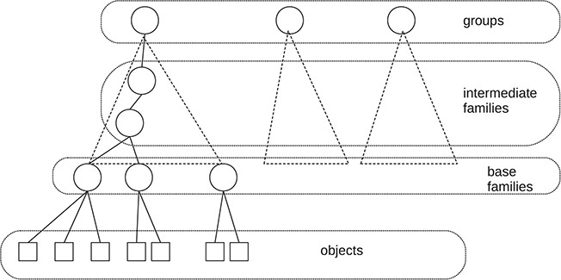
Fig. 1 Simplified structure of the web presentation of GtoPdb.
Notes:
Fig. 1 Simplified structure of the web presentation of GtoPdb.
Unless provided in the caption above, the following copyright applies to the content of this slide: © The Author(s) 2020. Published by Oxford University Press.This is an Open Access article distributed under the terms of the Creative Commons Attribution License (http://creativecommons.org/licenses/by/4.0/), which permits unrestricted reuse, distribution, and reproduction in any medium, provided the original work is properly cited.

Slide 2
Fig. 2 Former citation recommendations in GtoPdb.
Notes:
Fig. 2 Former citation recommendations in GtoPdb.
Unless provided in the caption above, the following copyright applies to the content of this slide: © The Author(s) 2020. Published by Oxford University Press.This is an Open Access article distributed under the terms of the Creative Commons Attribution License (http://creativecommons.org/licenses/by/4.0/), which permits unrestricted reuse, distribution, and reproduction in any medium, provided the original work is properly cited.

Slide 3
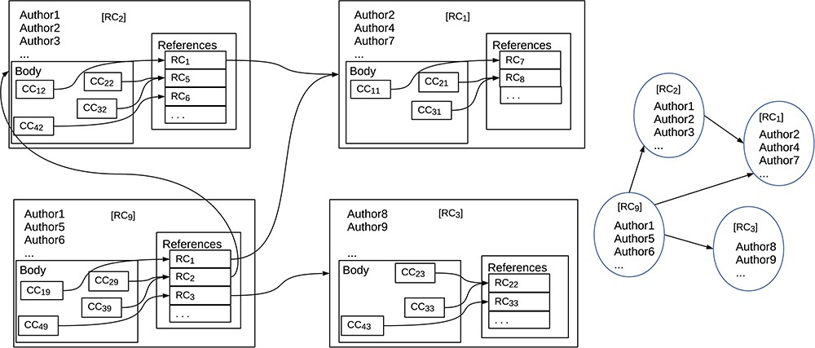
Fig. 3 References, citations and the associated citation graph.
Notes:
Fig. 3 References, citations and the associated citation graph.
Unless provided in the caption above, the following copyright applies to the content of this slide: © The Author(s) 2020. Published by Oxford University Press.This is an Open Access article distributed under the terms of the Creative Commons Attribution License (http://creativecommons.org/licenses/by/4.0/), which permits unrestricted reuse, distribution, and reproduction in any medium, provided the original work is properly cited.

Slide 4
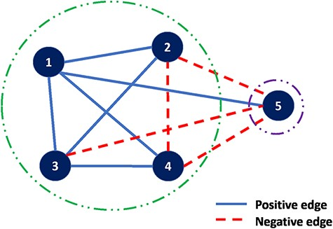
Fig. 4 Correlation clustering example.
Notes:
Fig. 4 Correlation clustering example.
Unless provided in the caption above, the following copyright applies to the content of this slide: © The Author(s) 2020. Published by Oxford University Press.This is an Open Access article distributed under the terms of the Creative Commons Attribution License (http://creativecommons.org/licenses/by/4.0/), which permits unrestricted reuse, distribution, and reproduction in any medium, provided the original work is properly cited.

Slide 5
Fig. 5 Examples of the use of correlation clustering algorithm in the hierarchical database; the left-hand side ...
Notes:
Fig. 5 Examples of the use of correlation clustering algorithm in the hierarchical database; the left-hand side represent the hierarchical structure of the example database while the right-hand side shows the clustering results.
Unless provided in the caption above, the following copyright applies to the content of this slide: © The Author(s) 2020. Published by Oxford University Press.This is an Open Access article distributed under the terms of the Creative Commons Attribution License (http://creativecommons.org/licenses/by/4.0/), which permits unrestricted reuse, distribution, and reproduction in any medium, provided the original work is properly cited.

Slide 6
Fig. 6 Stress statistics for GtoPdb families
Notes:
Fig. 6 Stress statistics for GtoPdb families
Unless provided in the caption above, the following copyright applies to the content of this slide: © The Author(s) 2020. Published by Oxford University Press.This is an Open Access article distributed under the terms of the Creative Commons Attribution License (http://creativecommons.org/licenses/by/4.0/), which permits unrestricted reuse, distribution, and reproduction in any medium, provided the original work is properly cited.

Slide 7
Fig. 7 A screenshot of the citations on a GtoPdb web page.
Notes:
Fig. 7 A screenshot of the citations on a GtoPdb web page.
Unless provided in the caption above, the following copyright applies to the content of this slide: © The Author(s) 2020. Published by Oxford University Press.This is an Open Access article distributed under the terms of the Creative Commons Attribution License (http://creativecommons.org/licenses/by/4.0/), which permits unrestricted reuse, distribution, and reproduction in any medium, provided the original work is properly cited.

Slide 8
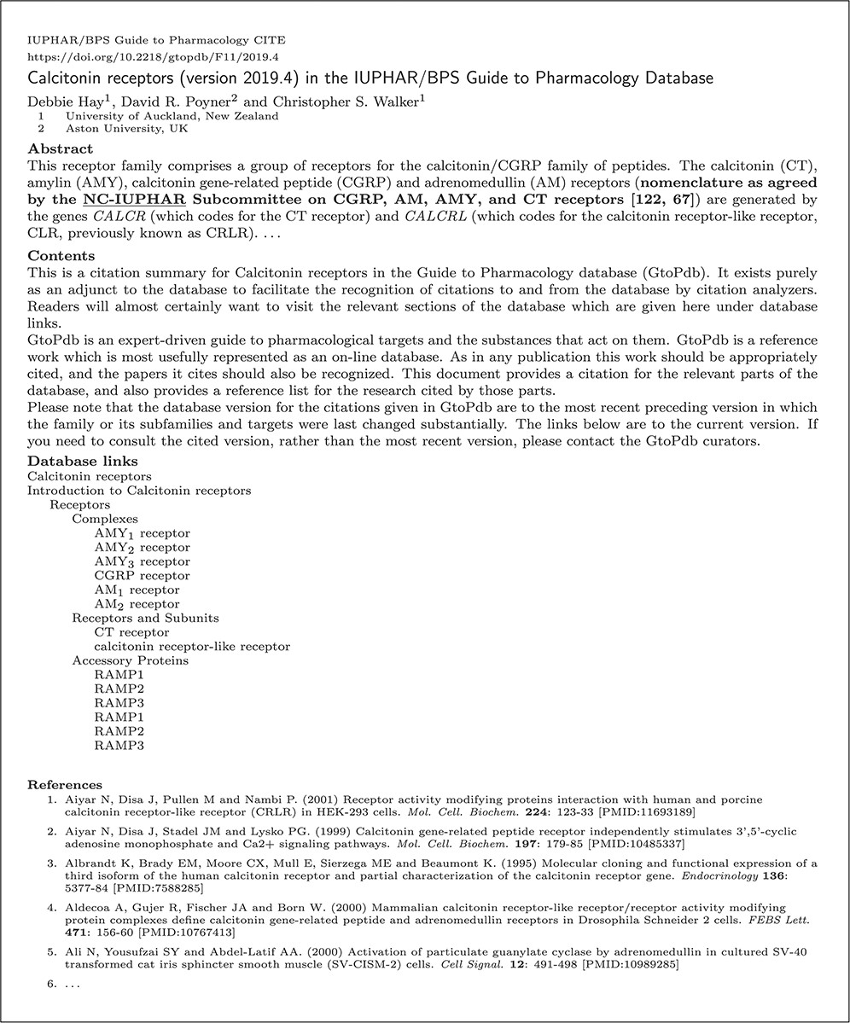
Fig. 8 Figure 8 Shows a heavily redacted (for reasons of space) summary that has been generated from GtoPdb. This is ...
Notes:
Fig. 8 Figure 8 Shows a heavily redacted (for reasons of space) summary that has been generated from GtoPdb. This is a paper (24) in the OJS Journal GtoPdb CITE. Electronic versions of this summary should provide working hypertext links to appropriate sections of the database and cited material.
Unless provided in the caption above, the following copyright applies to the content of this slide: © The Author(s) 2020. Published by Oxford University Press.This is an Open Access article distributed under the terms of the Creative Commons Attribution License (http://creativecommons.org/licenses/by/4.0/), which permits unrestricted reuse, distribution, and reproduction in any medium, provided the original work is properly cited.

