Slide 1
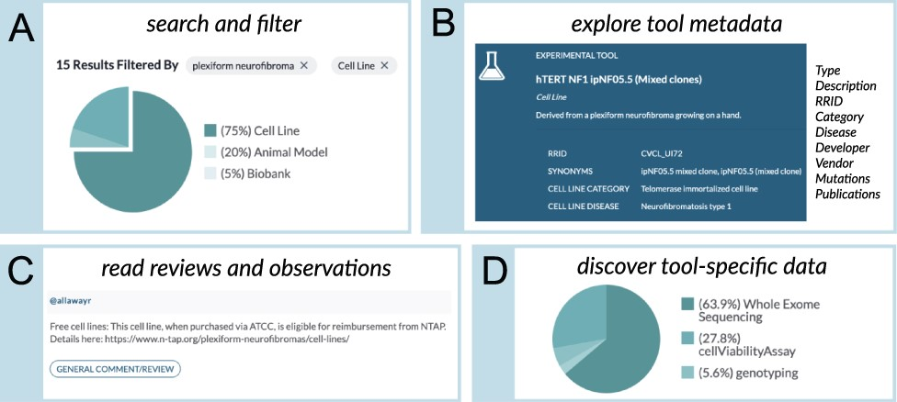
Figure 2. The ‘Browse Tools’ user interface of the NF Data Portal allows researchers to interactively explore the NF ...
Notes:
Figure 2. The ‘Browse Tools’ user interface of the NF Data Portal allows researchers to interactively explore the NF Research Tools Database. (A) Clickable chart-based filters allow database users to filter tools using standardized metadata. Users can also search the tools by typing in free-text search terms. (B) The ‘Tool Detail’ pages allow users to perform a deep dive into information about specific research tools, for example, metadata describing the tool, the tool developer and other information described in panels (C, D). For example, a ‘canonical’ publication, when available, is listed for each tool. The Tool Detail pages also include publications that describe the use of the tool. When relevant information is available, the mutation/engineering status of selected genes—for example, genes that have been modified with the Cre-lox system or genes that have spontaneous mutations—is also provided. When tools are commercially available, the database provides a link to an external vendor, such as ATCC. (C) The Tool Details page also presents ‘Observations’, which are user-submitted details that describe pathology, usage notes, issues, reviews or other information relevant to a particular experimental tool. (D) When available in the NF Data Portal, data generated using a particular tool (e.g. publicly shared drug screening data generated using a commercially available cell line) are listed on the ‘Data’ tab of the Tool Detail page.
Unless provided in the caption above, the following copyright applies to the content of this slide: © The Author(s) 2022. Published by Oxford University Press.This is an Open Access article distributed under the terms of the Creative Commons Attribution-NonCommercial License (https://creativecommons.org/licenses/by-nc/4.0/), which permits non-commercial re-use, distribution, and reproduction in any medium, provided the original work is properly cited. For commercial re-use, please contact journals.permissions@oup.com

