Slide 1
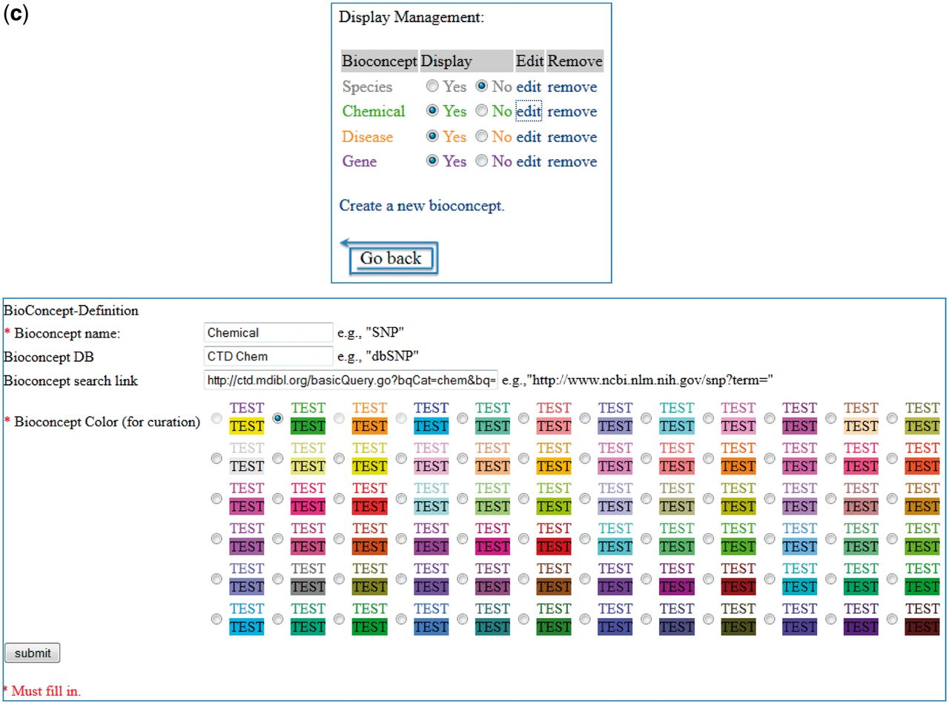
Figure 7 (a) Group 121 web interface. A screenshot of Group 121’s ranked list of chemicals for curation in their web ...
Notes:
Figure 7 (a) Group 121 web interface. A screenshot of Group 121’s ranked list of chemicals for curation in their web interface. (b) A screenshot of Group 121’s curation detail page in their web interface. (c) Screenshots of two of Group 121’s data management-related pages in their web interface.
Unless provided in the caption above, the following copyright applies to the content of this slide: © The Author(s) 2012. Published by Oxford University Press.This is an Open Access article distributed under the terms of the Creative Commons Attribution License (http://creativecommons.org/licenses/by-nc/3.0/), which permits non-commercial reuse, distribution, and reproduction in any medium, provided the original work is properly cited. For commercial re-use, please contact journals.permissions@oup.com.

