Slide 1
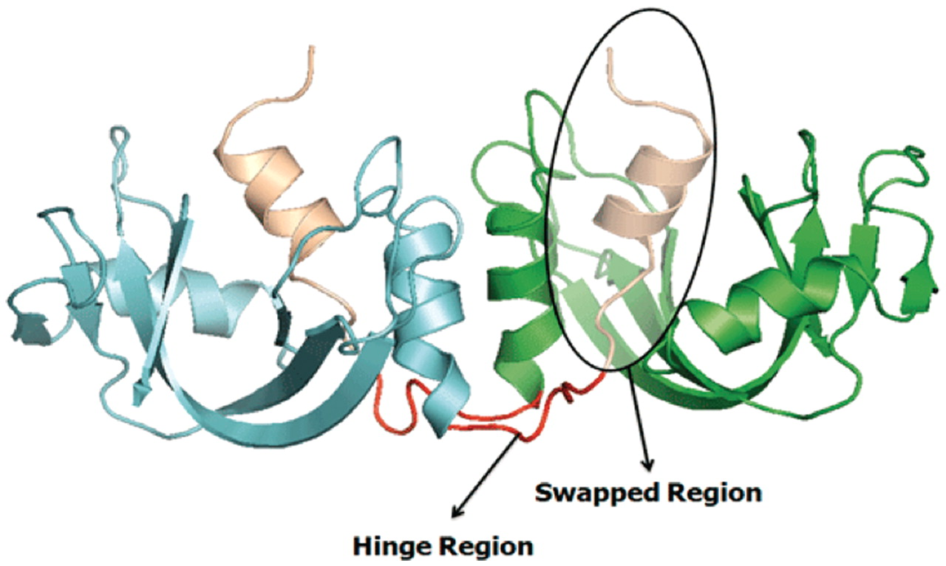
Figure 1. Example of a bona fide domain swapping structure: bovine seminal ribonuclease (PDB ID: 11BG) in 3D domain ...
Notes:
Figure 1. Example of a bona fide domain swapping structure: bovine seminal ribonuclease (PDB ID: 11BG) in 3D domain swap conformation with highlighted hinge and swapped regions. Individual chains are colored in cyan and green. Hinge regions are colored in red and swapped region is colored in coffee brown.
Unless provided in the caption above, the following copyright applies to the content of this slide: © The Author(s) 2011. Published by Oxford University Press.This is Open Access article distributed under the terms of the Creative Commons Attribution Non-Commercial License (http://creativecommons.org/licenses/by-nc/2.5), which permits unrestricted non-commercial use, distribution, and reproduction in any medium, provided the original work is properly cited.

Slide 2
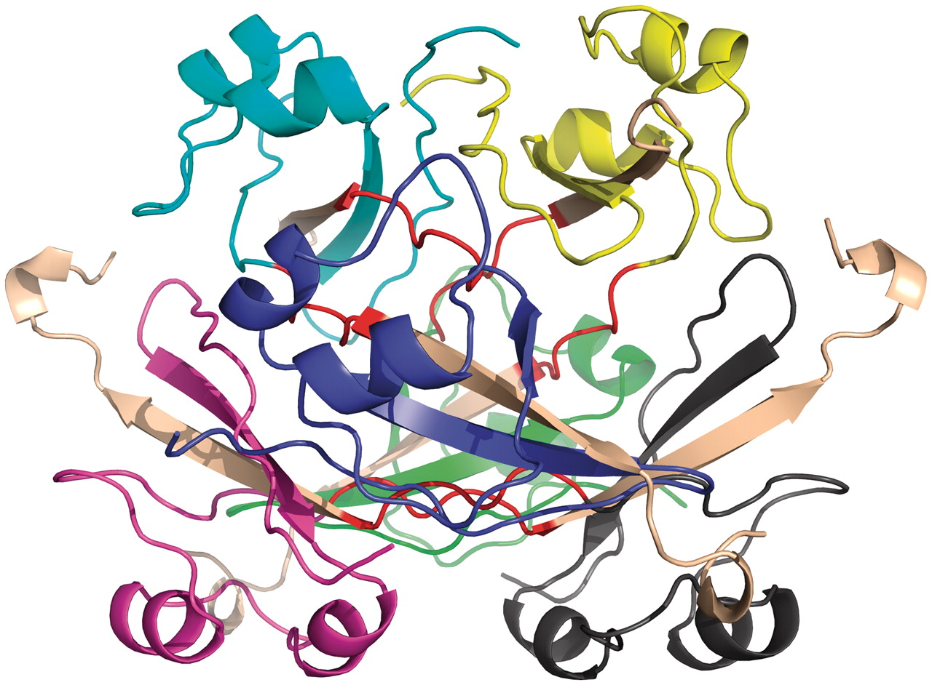
Figure 2. Example of quasidomain swapping structure: hexameric assembly of human CksHs2 (PDB ID: 1CKS). Six individual ...
Notes:
Figure 2. Example of quasidomain swapping structure: hexameric assembly of human CksHs2 (PDB ID: 1CKS). Six individual chains are colored in different colors (yellow, cyan, violet, blue, green, gray). Hinge regions are colored in red and swapped region is colored in coffee brown.
Unless provided in the caption above, the following copyright applies to the content of this slide: © The Author(s) 2011. Published by Oxford University Press.This is Open Access article distributed under the terms of the Creative Commons Attribution Non-Commercial License (http://creativecommons.org/licenses/by-nc/2.5), which permits unrestricted non-commercial use, distribution, and reproduction in any medium, provided the original work is properly cited.

Slide 3
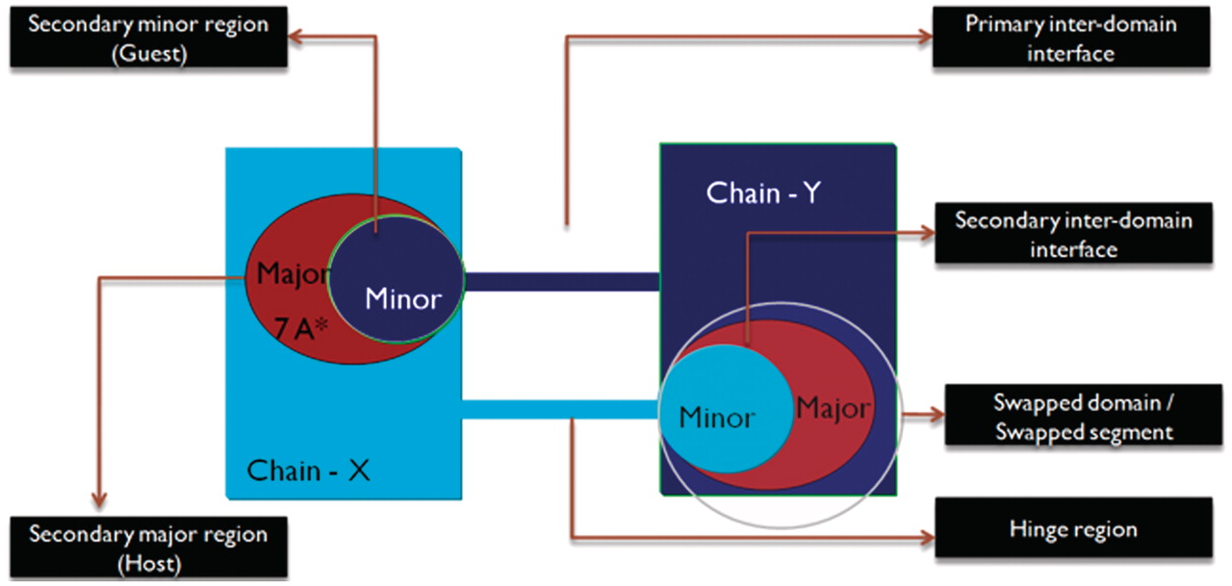
Figure 3. Schematic representation of the different features of 3D domain swapping.
Notes:
Figure 3. Schematic representation of the different features of 3D domain swapping.
Unless provided in the caption above, the following copyright applies to the content of this slide: © The Author(s) 2011. Published by Oxford University Press.This is Open Access article distributed under the terms of the Creative Commons Attribution Non-Commercial License (http://creativecommons.org/licenses/by-nc/2.5), which permits unrestricted non-commercial use, distribution, and reproduction in any medium, provided the original work is properly cited.

Slide 4
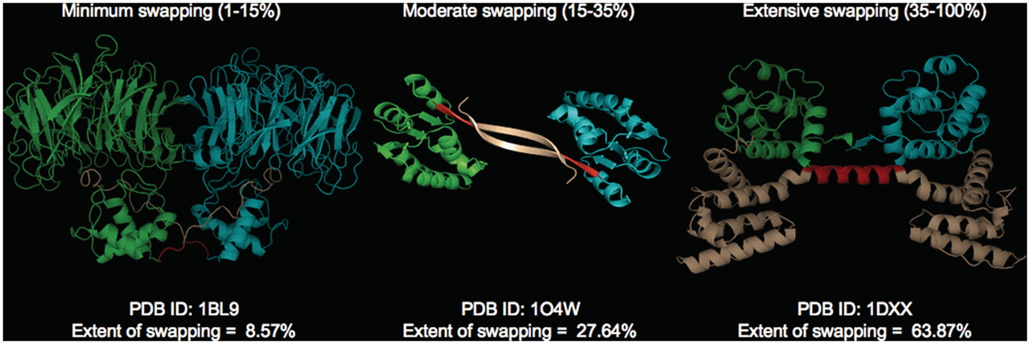
Figure 4. Different classes of ‘ES’ with representative examples (PDB IDs: 1BL9,1O4W and 1DXX). Individual chains are ...
Notes:
Figure 4. Different classes of ‘ES’ with representative examples (PDB IDs: 1BL9,1O4W and 1DXX). Individual chains are colored in cyan and green. Hinge (red) and swapped regions (brown) are mapped in different colors.
Unless provided in the caption above, the following copyright applies to the content of this slide: © The Author(s) 2011. Published by Oxford University Press.This is Open Access article distributed under the terms of the Creative Commons Attribution Non-Commercial License (http://creativecommons.org/licenses/by-nc/2.5), which permits unrestricted non-commercial use, distribution, and reproduction in any medium, provided the original work is properly cited.

Slide 5
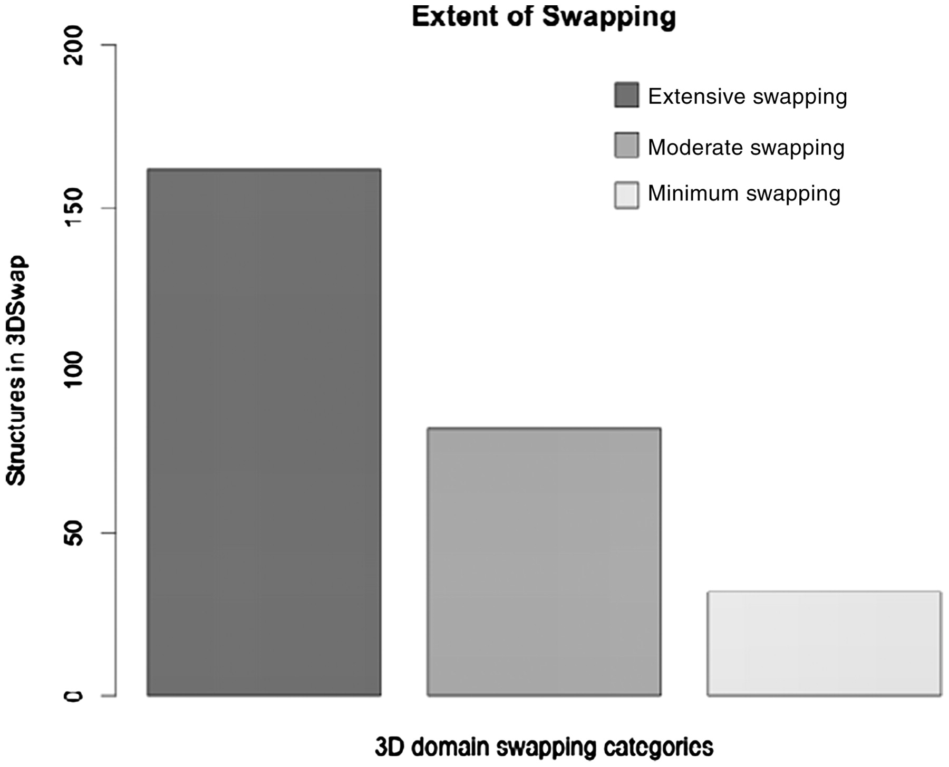
Figure 5. Distribution of protein in the data set based on ES.
Notes:
Figure 5. Distribution of protein in the data set based on ES.
Unless provided in the caption above, the following copyright applies to the content of this slide: © The Author(s) 2011. Published by Oxford University Press.This is Open Access article distributed under the terms of the Creative Commons Attribution Non-Commercial License (http://creativecommons.org/licenses/by-nc/2.5), which permits unrestricted non-commercial use, distribution, and reproduction in any medium, provided the original work is properly cited.

Slide 6
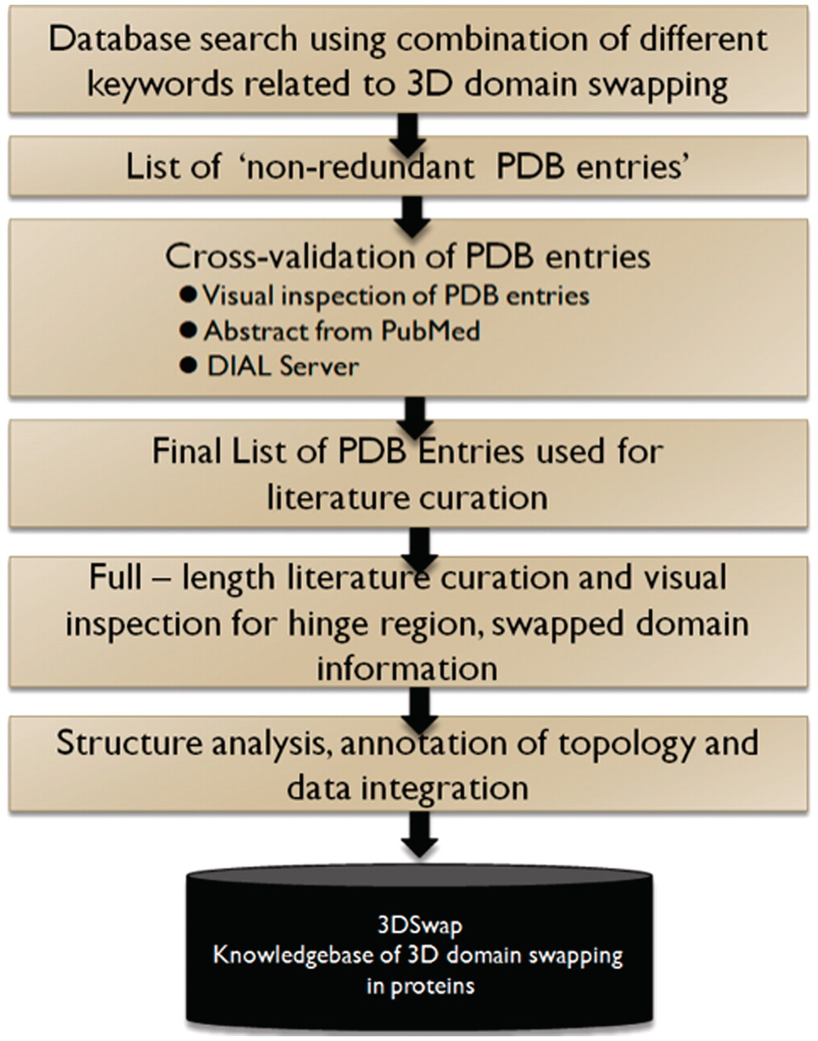
Figure 6. A schematic representation of curation steps involved in the development of 3DSwap knowledgebase.
Notes:
Figure 6. A schematic representation of curation steps involved in the development of 3DSwap knowledgebase.
Unless provided in the caption above, the following copyright applies to the content of this slide: © The Author(s) 2011. Published by Oxford University Press.This is Open Access article distributed under the terms of the Creative Commons Attribution Non-Commercial License (http://creativecommons.org/licenses/by-nc/2.5), which permits unrestricted non-commercial use, distribution, and reproduction in any medium, provided the original work is properly cited.

Slide 7
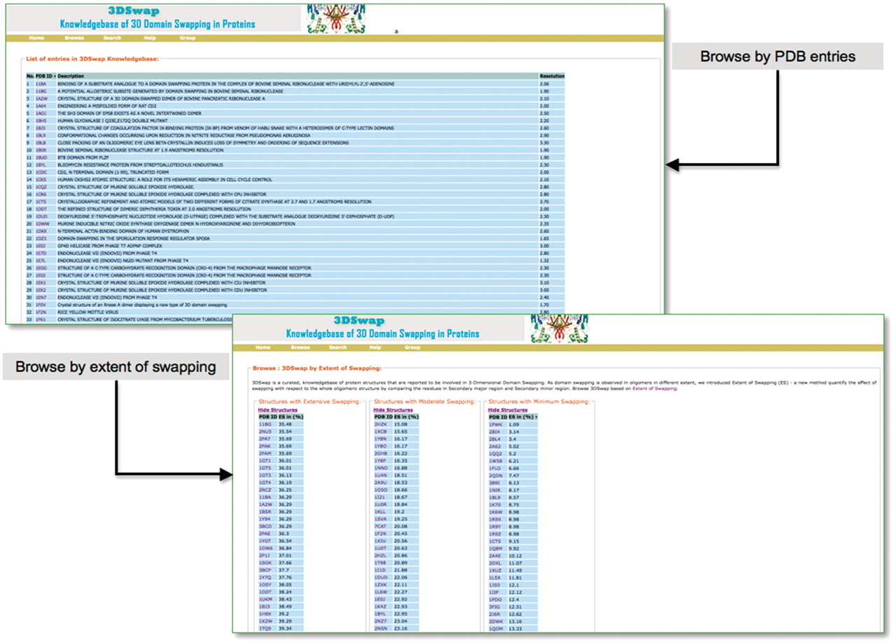
Figure 7. Browse interfaces of 3DSwap.
Notes:
Figure 7. Browse interfaces of 3DSwap.
Unless provided in the caption above, the following copyright applies to the content of this slide: © The Author(s) 2011. Published by Oxford University Press.This is Open Access article distributed under the terms of the Creative Commons Attribution Non-Commercial License (http://creativecommons.org/licenses/by-nc/2.5), which permits unrestricted non-commercial use, distribution, and reproduction in any medium, provided the original work is properly cited.

Slide 8
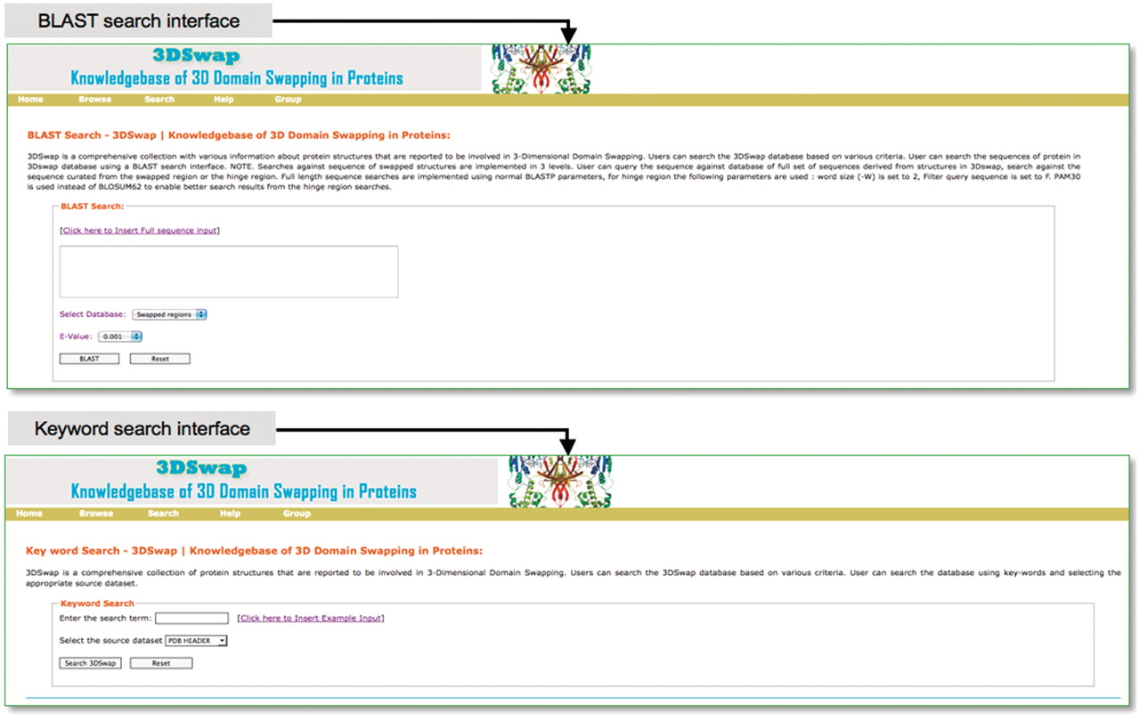
Figure 8. Search interfaces of 3DSwap.
Notes:
Figure 8. Search interfaces of 3DSwap.
Unless provided in the caption above, the following copyright applies to the content of this slide: © The Author(s) 2011. Published by Oxford University Press.This is Open Access article distributed under the terms of the Creative Commons Attribution Non-Commercial License (http://creativecommons.org/licenses/by-nc/2.5), which permits unrestricted non-commercial use, distribution, and reproduction in any medium, provided the original work is properly cited.

Slide 9
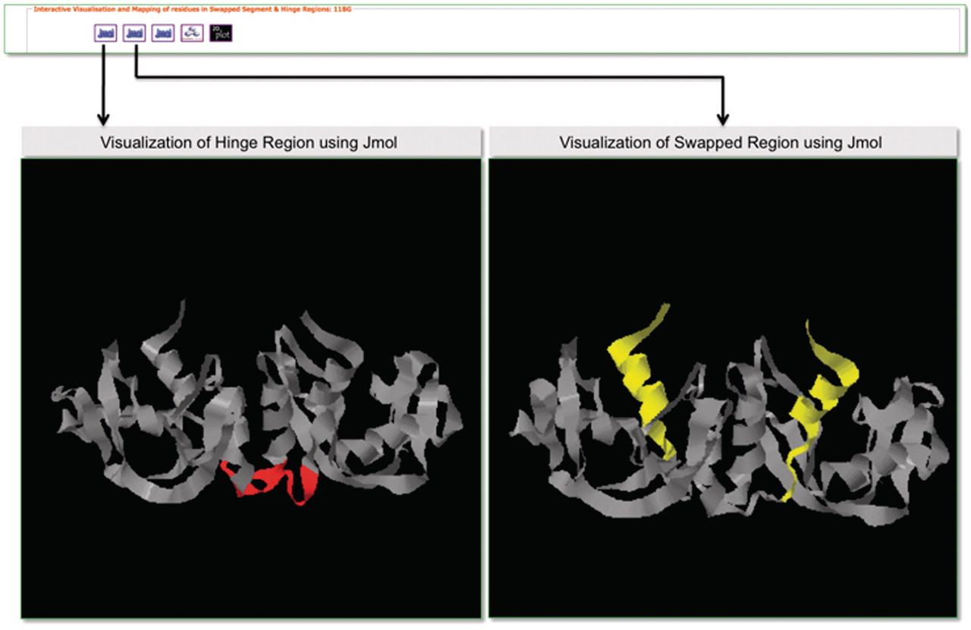
Figure 9. Screenshot that highlights visualization in 3DSwap using Jmol.
Notes:
Figure 9. Screenshot that highlights visualization in 3DSwap using Jmol.
Unless provided in the caption above, the following copyright applies to the content of this slide: © The Author(s) 2011. Published by Oxford University Press.This is Open Access article distributed under the terms of the Creative Commons Attribution Non-Commercial License (http://creativecommons.org/licenses/by-nc/2.5), which permits unrestricted non-commercial use, distribution, and reproduction in any medium, provided the original work is properly cited.

Slide 10
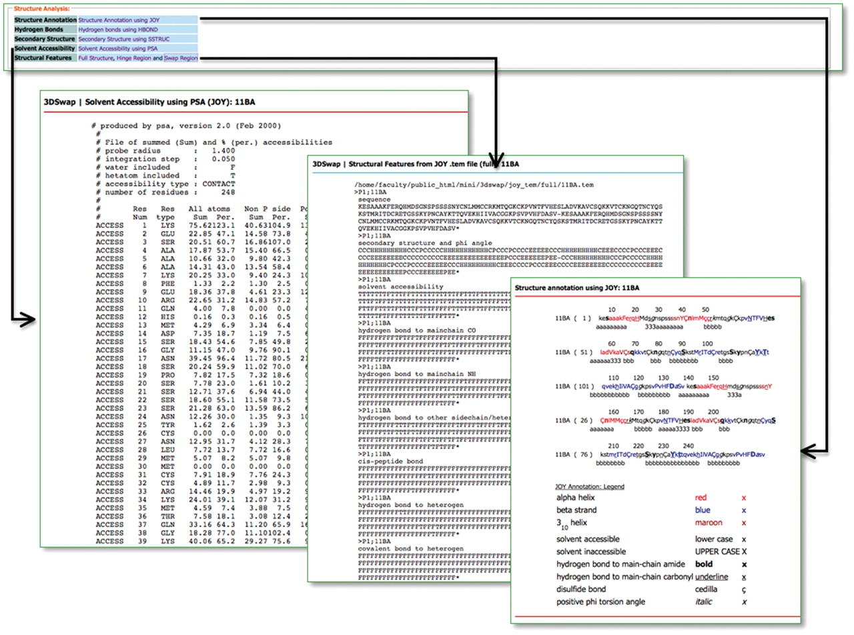
Figure 10. Structural features in 3DSwap.
Notes:
Figure 10. Structural features in 3DSwap.
Unless provided in the caption above, the following copyright applies to the content of this slide: © The Author(s) 2011. Published by Oxford University Press.This is Open Access article distributed under the terms of the Creative Commons Attribution Non-Commercial License (http://creativecommons.org/licenses/by-nc/2.5), which permits unrestricted non-commercial use, distribution, and reproduction in any medium, provided the original work is properly cited.

Slide 11
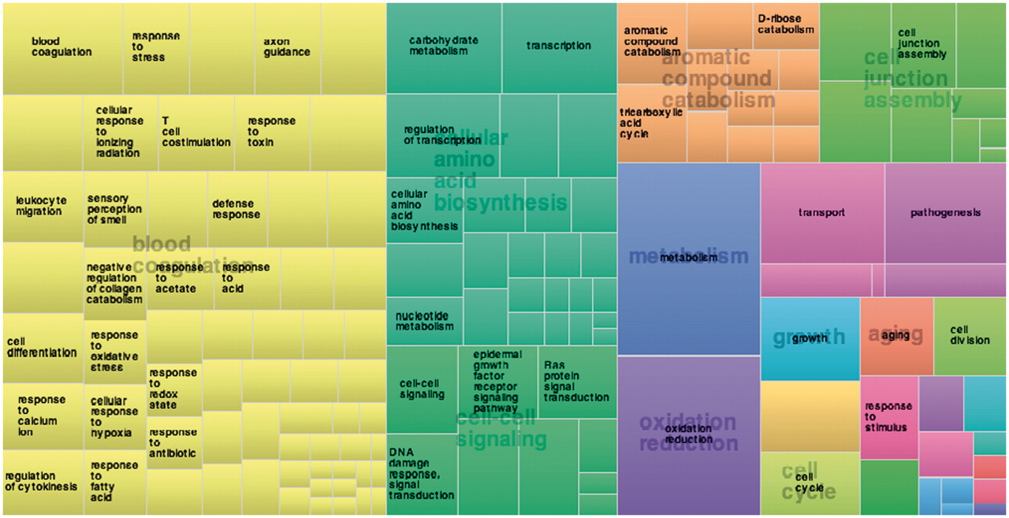
Figure 11. Treemap derived using frequency of proteins annotated in 3DSwap using biological process category.
Notes:
Figure 11. Treemap derived using frequency of proteins annotated in 3DSwap using biological process category.
Unless provided in the caption above, the following copyright applies to the content of this slide: © The Author(s) 2011. Published by Oxford University Press.This is Open Access article distributed under the terms of the Creative Commons Attribution Non-Commercial License (http://creativecommons.org/licenses/by-nc/2.5), which permits unrestricted non-commercial use, distribution, and reproduction in any medium, provided the original work is properly cited.

Slide 12
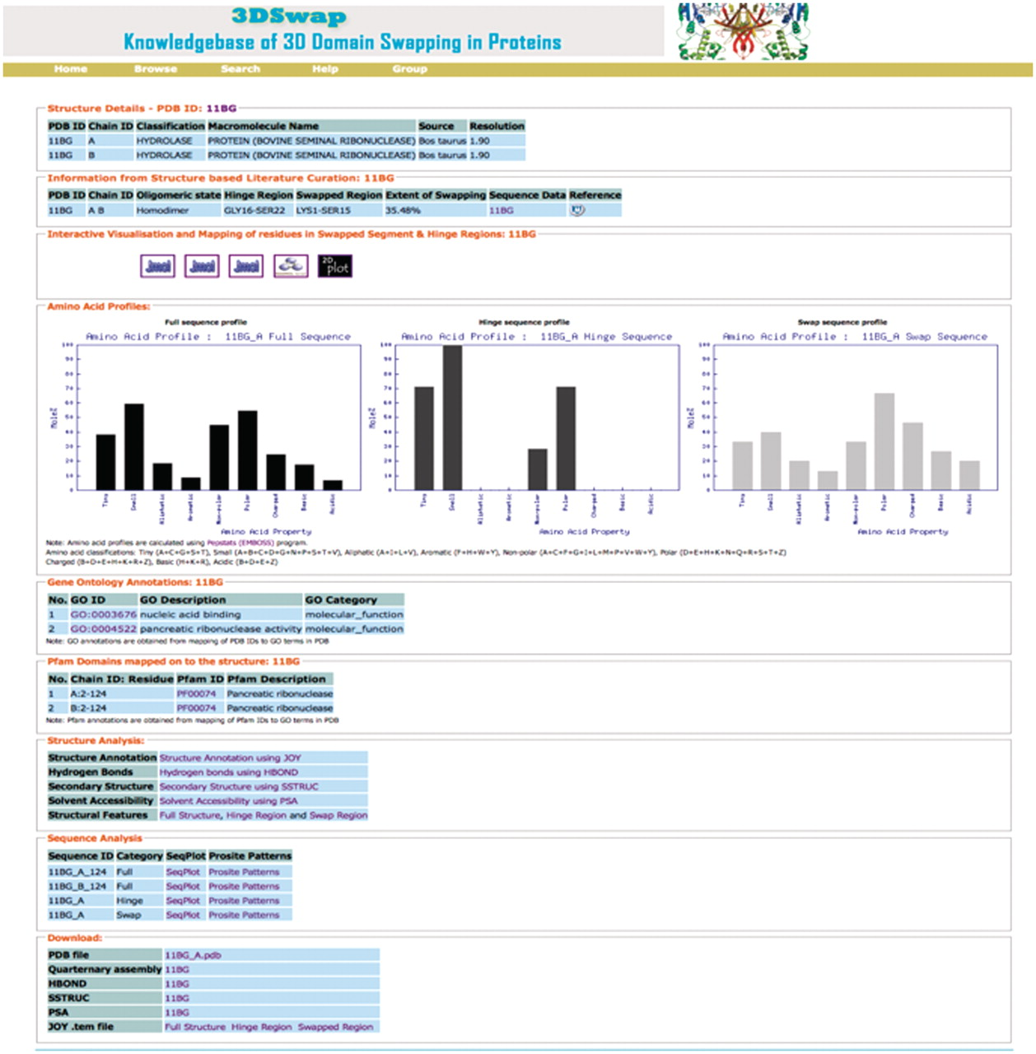
Figure 12. Screen shot of 3DSwap knowledgebase for the PDB ID: 11BG.
Notes:
Figure 12. Screen shot of 3DSwap knowledgebase for the PDB ID: 11BG.
Unless provided in the caption above, the following copyright applies to the content of this slide: © The Author(s) 2011. Published by Oxford University Press.This is Open Access article distributed under the terms of the Creative Commons Attribution Non-Commercial License (http://creativecommons.org/licenses/by-nc/2.5), which permits unrestricted non-commercial use, distribution, and reproduction in any medium, provided the original work is properly cited.

Slide 13
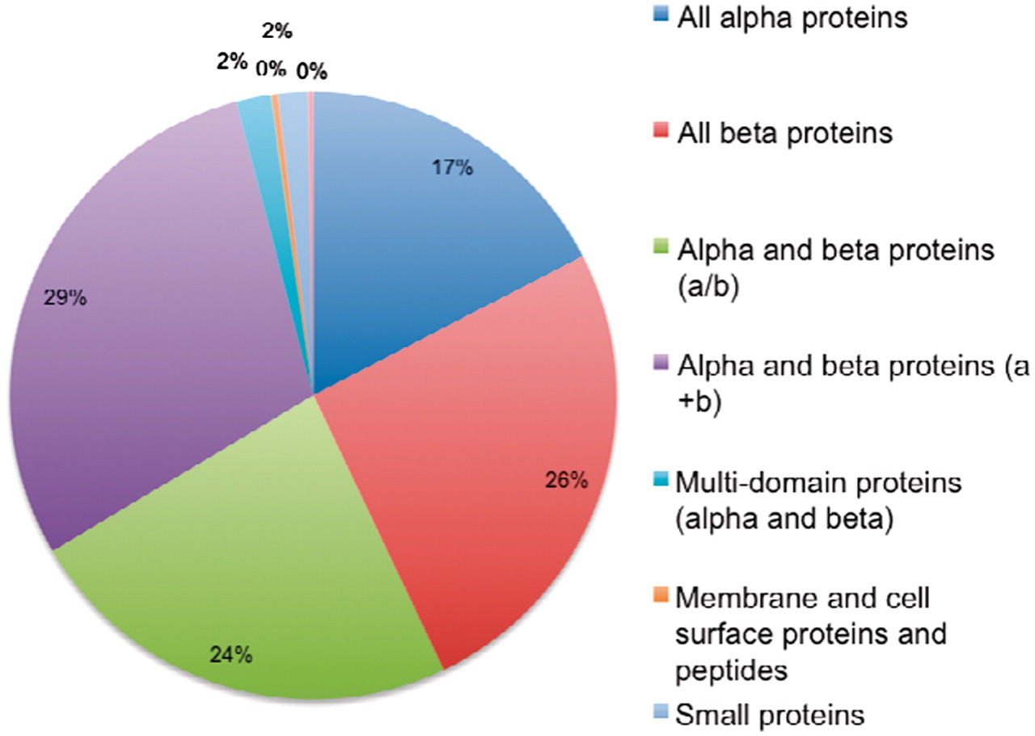
Figure 13. Distribution of protein structures in 3DSwap in SCOP classes.
Notes:
Figure 13. Distribution of protein structures in 3DSwap in SCOP classes.
Unless provided in the caption above, the following copyright applies to the content of this slide: © The Author(s) 2011. Published by Oxford University Press.This is Open Access article distributed under the terms of the Creative Commons Attribution Non-Commercial License (http://creativecommons.org/licenses/by-nc/2.5), which permits unrestricted non-commercial use, distribution, and reproduction in any medium, provided the original work is properly cited.

