Slide 1
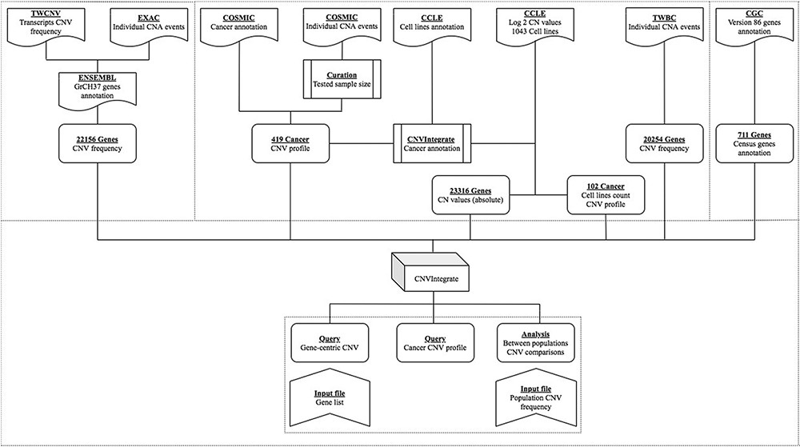
Figure 1. Overview of CNVIntegrate.
Notes:
Figure 1. Overview of CNVIntegrate.
Unless provided in the caption above, the following copyright applies to the content of this slide: © The Author(s) 2021. Published by Oxford University Press.This is an Open Access article distributed under the terms of the Creative Commons Attribution License (http://creativecommons.org/licenses/by/4.0/), which permits unrestricted reuse, distribution, and reproduction in any medium, provided the original work is properly cited.

Slide 2
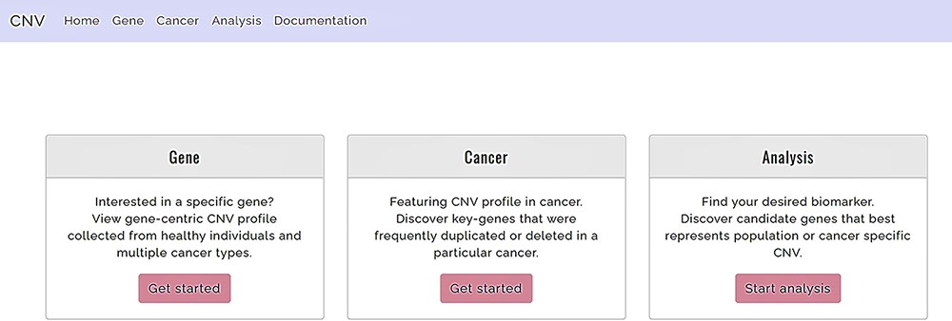
Figure 2. Functions offered by CNVIntegrate—gene, cancer and analysis (i) Gene: gene-query function. (ii) Cancer: ...
Notes:
Figure 2. Functions offered by CNVIntegrate—gene, cancer and analysis (i) Gene: gene-query function. (ii) Cancer: cancer profile function. (iii) Analysis: analysis function.
Unless provided in the caption above, the following copyright applies to the content of this slide: © The Author(s) 2021. Published by Oxford University Press.This is an Open Access article distributed under the terms of the Creative Commons Attribution License (http://creativecommons.org/licenses/by/4.0/), which permits unrestricted reuse, distribution, and reproduction in any medium, provided the original work is properly cited.

Slide 3
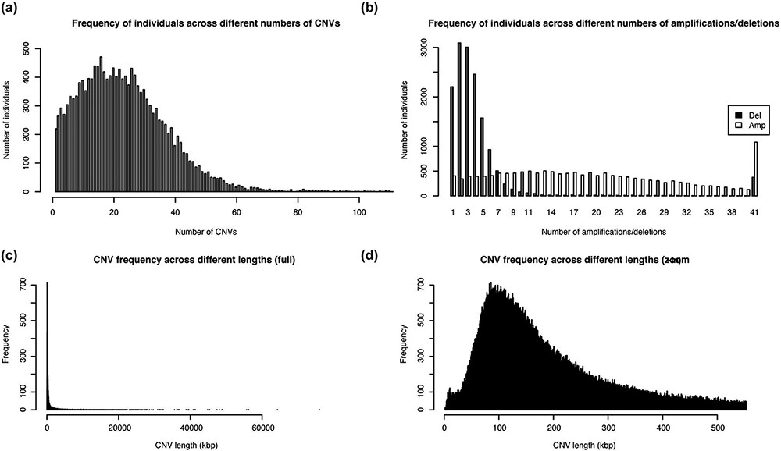
Figure 3. Distribution of the number and length of CNVs across the 15 829 Taiwanese people in TWCNV (a) Distribution of ...
Notes:
Figure 3. Distribution of the number and length of CNVs across the 15 829 Taiwanese people in TWCNV (a) Distribution of CNV counts in the population. (b) Distribution of duplication and deletion counts separately in the population. In (a) and (b), the number of individuals (y-axis) were plotted against the CNV counts (x-axis). (c) Distribution of lengths of the identified distinct CNVs. (d) Partial distribution of lengths of the identified distinct CNVs. In (d), CNV lengths ranging from 1 to 500 kb were further enlarged from the left figure. In (c) and (d), the unit of CNV lengths was kilobase pairs (kb) on the x-axis, and the exact CNV counts were shown on the y-axis.
Unless provided in the caption above, the following copyright applies to the content of this slide: © The Author(s) 2021. Published by Oxford University Press.This is an Open Access article distributed under the terms of the Creative Commons Attribution License (http://creativecommons.org/licenses/by/4.0/), which permits unrestricted reuse, distribution, and reproduction in any medium, provided the original work is properly cited.

Slide 4
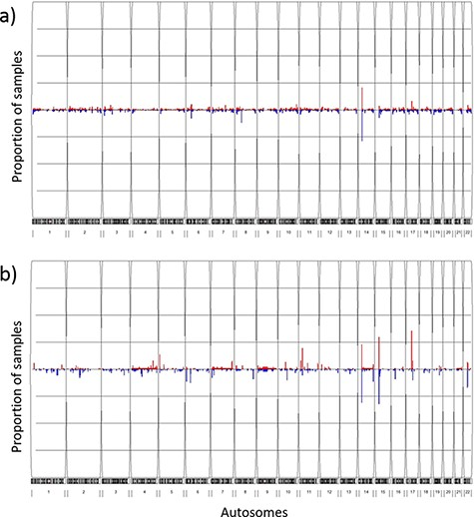
Figure 4. Frequency plots of CNVs in the TWCNV and HapMap datasets Red color represents duplication while blue color ...
Notes:
Figure 4. Frequency plots of CNVs in the TWCNV and HapMap datasets Red color represents duplication while blue color represents deletion. The x-axis contains the 22 autosomes, and the y-axis shows the proportion of samples showing CNVs in the two datasets. (a) Frequency plot of CNVs in 15 829 Taiwanese individuals. (b) Frequency plot of CNVs in 87 Asians in the HapMap dataset.
Unless provided in the caption above, the following copyright applies to the content of this slide: © The Author(s) 2021. Published by Oxford University Press.This is an Open Access article distributed under the terms of the Creative Commons Attribution License (http://creativecommons.org/licenses/by/4.0/), which permits unrestricted reuse, distribution, and reproduction in any medium, provided the original work is properly cited.

Slide 5
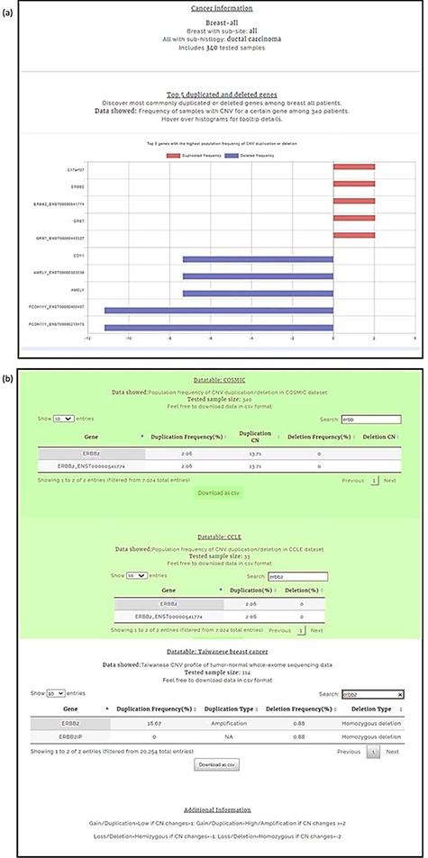
Figure 5. Breast carcinoma profile from the four-level hierarchy query system (a) Top five genes with the highest ...
Notes:
Figure 5. Breast carcinoma profile from the four-level hierarchy query system (a) Top five genes with the highest population frequency of CNV duplication or deletion. (b) Population frequency of CNV duplication/deletion in the CCLE, COSMIC and TWBC datasets.
Unless provided in the caption above, the following copyright applies to the content of this slide: © The Author(s) 2021. Published by Oxford University Press.This is an Open Access article distributed under the terms of the Creative Commons Attribution License (http://creativecommons.org/licenses/by/4.0/), which permits unrestricted reuse, distribution, and reproduction in any medium, provided the original work is properly cited.

Slide 6
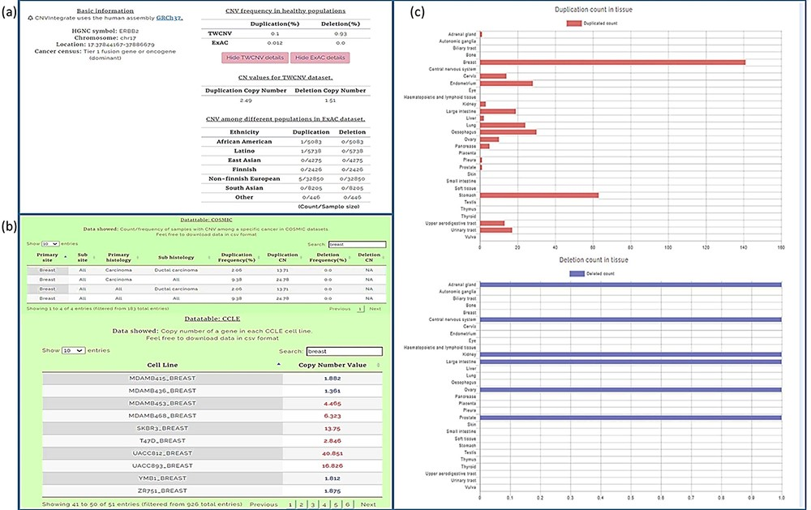
Figure 6. Query results for ERBB2 gene showing CNV frequencies in both healthy populations and cancer populations (a) ...
Notes:
Figure 6. Query results for ERBB2 gene showing CNV frequencies in both healthy populations and cancer populations (a) CNV frequency/counts of the ERBB2 gene in the TWCNV (healthy) dataset and CNV frequency of ERBB2 among different populations (healthy) in the ExAC dataset. (b) Count/frequency of breast cancer samples with CNV in the COSMIC dataset; CN of the ERBB2 gene in CCLE breast cell lines. (c) Duplication and deletion counts of the ERBB2 gene in different tissues.
Unless provided in the caption above, the following copyright applies to the content of this slide: © The Author(s) 2021. Published by Oxford University Press.This is an Open Access article distributed under the terms of the Creative Commons Attribution License (http://creativecommons.org/licenses/by/4.0/), which permits unrestricted reuse, distribution, and reproduction in any medium, provided the original work is properly cited.

Slide 7
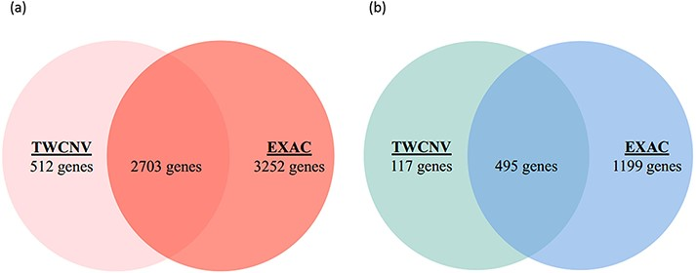
Figure 7. Venn diagrams of significant gene counts from the analysis function (a) Significant CN gains (Red) were ...
Notes:
Figure 7. Venn diagrams of significant gene counts from the analysis function (a) Significant CN gains (Red) were observed in 2703 genes among lung adenocarcinoma patients from both TWCNV and ExAC populations. (b) Significant CN losses (Blue) were observed in 495 genes among lung adenocarcinoma patients from both TWCNV and ExAC populations.
Unless provided in the caption above, the following copyright applies to the content of this slide: © The Author(s) 2021. Published by Oxford University Press.This is an Open Access article distributed under the terms of the Creative Commons Attribution License (http://creativecommons.org/licenses/by/4.0/), which permits unrestricted reuse, distribution, and reproduction in any medium, provided the original work is properly cited.

