Slide 1
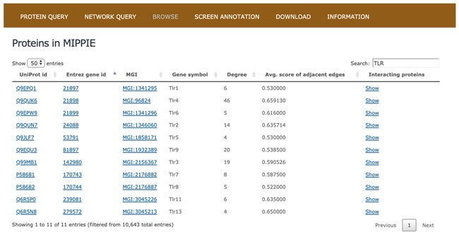
Figure 2 The BROWSE tab in MIPPIE shows a table with the proteome available in the database. Each protein in the table ...
Notes:
Figure 2 The BROWSE tab in MIPPIE shows a table with the proteome available in the database. Each protein in the table is listed with its UniProt, Entrez, MGI and Symbol identifiers, as well as its degree (number of interaction partners), the average MIPPIE score of the interactions in which the protein is involved and a link to explore the network around the protein.
Unless provided in the caption above, the following copyright applies to the content of this slide: © The Author(s) 2020. Published by Oxford University Press.This is an Open Access article distributed under the terms of the Creative Commons Attribution License (http://creativecommons.org/licenses/by/4.0/), which permits unrestricted reuse, distribution, and reproduction in any medium, provided the original work is properly cited.

