Slide 1
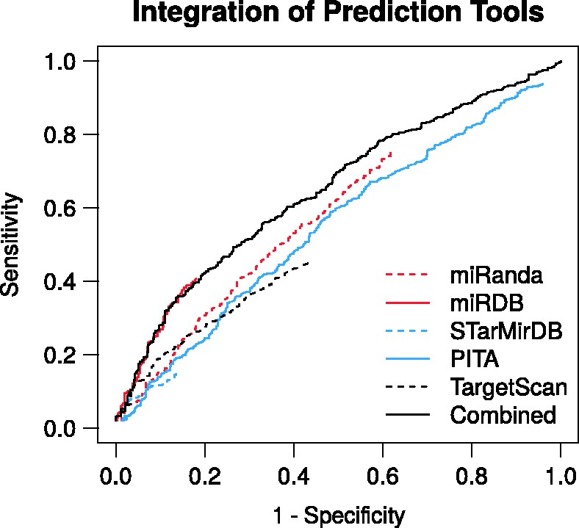
Figure 3 Receiver-operating characteristics of the RAIN prediction channel and the respective miRNA target prediction ...
Notes:
Figure 3 Receiver-operating characteristics of the RAIN prediction channel and the respective miRNA target prediction tools benchmarked against an independent validation set of miRNA–mRNA interactions. The integration of the respective prediction tools yields improved predictive performance. Where specificity =TN/N, sensitivity =TP/P, P is the number of positive and n the number of negative miRNA–mRNA pairs.
Unless provided in the caption above, the following copyright applies to the content of this slide: © The Author(s) 2017. Published by Oxford University Press.This is an Open Access article distributed under the terms of the Creative Commons Attribution Non-Commercial License (http://creativecommons.org/licenses/by-nc/4.0/), which permits non-commercial re-use, distribution, and reproduction in any medium, provided the original work is properly cited. For commercial re-use, please contact journals.permissions@oup.com

