Slide 1
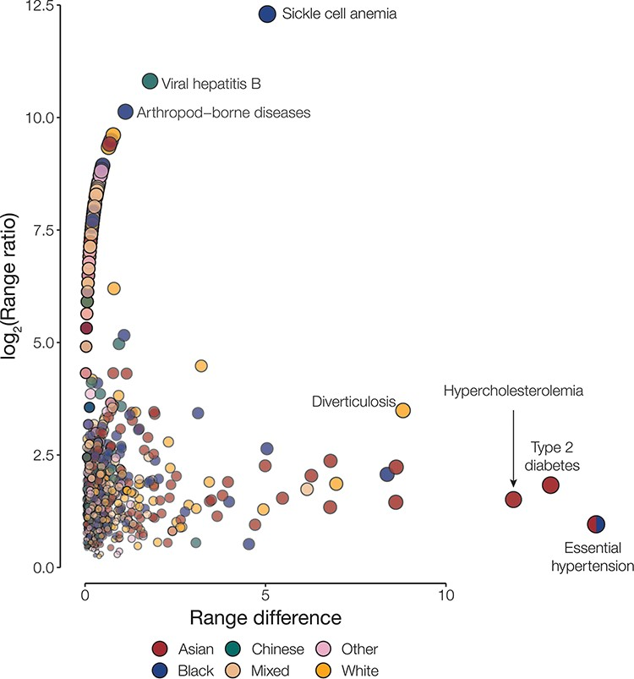
Figure 1. Disease disparities for ethnic groups. Disparities are quantified by the range ratio (y-axis) and the range ...
Notes:
Figure 1. Disease disparities for ethnic groups. Disparities are quantified by the range ratio (y-axis) and the range difference (x-axis) as described in the Methods section. Each point is a disease phenotype and is colored to indicate the ethnic groups with the highest prevalence for that phenotype. The size and opacity of each point are scaled by the Euclidean distance from the origin.
Unless provided in the caption above, the following copyright applies to the content of this slide: Published by Oxford University Press 2023. This work is written by (a) US Government employee(s) and is in the public domain in the US.This work is written by (a) US Government employee(s) and is in the public domain in the US.

