Slide 1
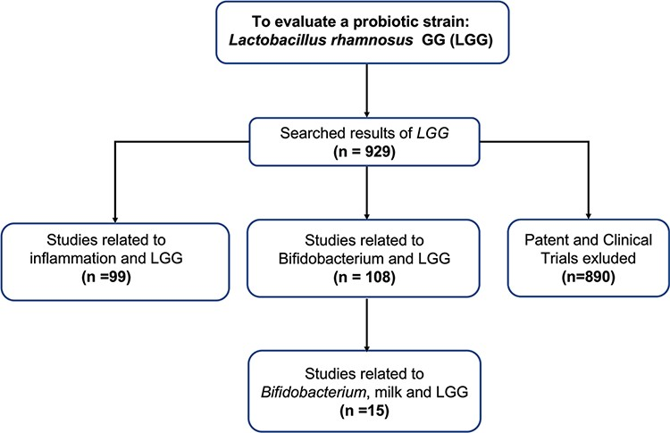
Figure 6. Flowchart of using ProBioQuest to evaluate a probiotic strain-Lactobacillus rhamnosus GG. Searching ...
Notes:
Figure 6. Flowchart of using ProBioQuest to evaluate a probiotic strain-Lactobacillus rhamnosus GG. Searching Lactobacillus rhamnosus GG in ProbioQuest returned 929 results. There were 890 articles from Pudmed.gov. To narrow down the number of results to those of more specific interest, a second keyword (‘Bifidobacterium’ or ‘inflammation’) was added. This reduced the number of results to 108 and 99, respectively. The addition of more keywords would further reduce the number of results and narrow the field of enquiry.
Unless provided in the caption above, the following copyright applies to the content of this slide: © The Author(s) 2022. Published by Oxford University Press.This is an Open Access article distributed under the terms of the Creative Commons Attribution-NonCommercial License (https://creativecommons.org/licenses/by-nc/4.0/), which permits non-commercial re-use, distribution, and reproduction in any medium, provided the original work is properly cited. For commercial re-use, please contact journals.permissions@oup.com

