Slide 1
Figure 2. Illustration of common and different chemical annotations in the chemical annotated data [The overlap of ...
Notes:
Figure 2. Illustration of common and different chemical annotations in the chemical annotated data [The overlap of chemical mention annotations is shown in (a), the overlap of MeSH ID annotations is shown in (b) and the overlap of the indexed chemical substances is shown in (c)]. Please note that this depiction does not preserve the relative size of corpora. The NLM-Chem dataset of full-text articles brings in additional previously unseen chemical mentions and chemical identifiers.
Unless provided in the caption above, the following copyright applies to the content of this slide: Published by Oxford University Press 2022. This work is written by (a) US Government employee(s) and is in the public domain in the US.This work is written by (a) US Government employee(s) and is in the public domain in the US.

Slide 2
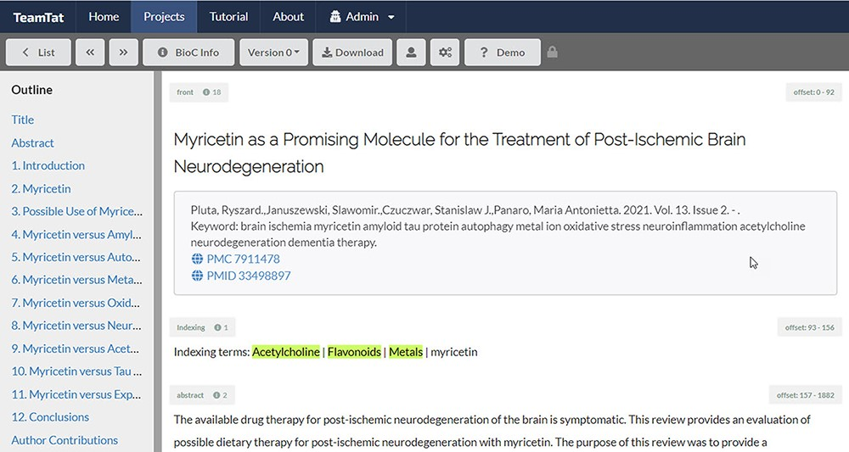
Figure 1. Illustration of indexing review in TeamTat. Every article was reviewed by two indexers. The image shows a ...
Notes:
Figure 1. Illustration of indexing review in TeamTat. Every article was reviewed by two indexers. The image shows a screenshot of the article and a section under the article title named ‘Indexing terms’. All the chemical terms to be reviewed for each article are listed in this section. The NLM indexers highlighted the chemical indexing terms that best represented the article topics.
Unless provided in the caption above, the following copyright applies to the content of this slide: Published by Oxford University Press 2022. This work is written by (a) US Government employee(s) and is in the public domain in the US.This work is written by (a) US Government employee(s) and is in the public domain in the US.

