Slide 1
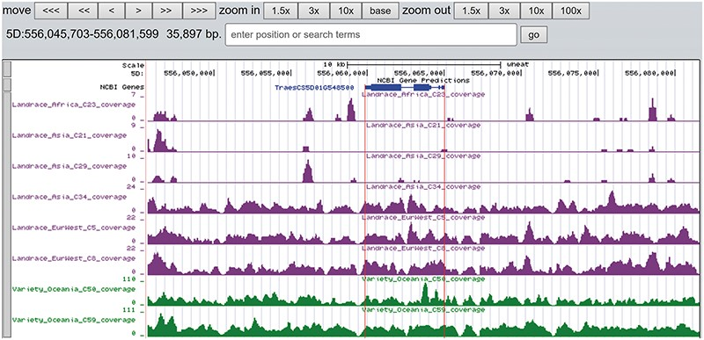
Figure 6. The read coverage depth on the region of gene TraesCS5D01G548500 in eight bread wheat accessions. The gene is ...
Notes:
Figure 6. The read coverage depth on the region of gene TraesCS5D01G548500 in eight bread wheat accessions. The gene is absent in three landrace (C21, C23 and C29) as indicated by the few reads alignment, while it is present in the other five accessions.
Unless provided in the caption above, the following copyright applies to the content of this slide: © The Author(s) 2020. Published by Oxford University Press.This is an Open Access article distributed under the terms of the Creative Commons Attribution License (http://creativecommons.org/licenses/by/4.0/), which permits unrestricted reuse, distribution, and reproduction in any medium, provided the original work is properly cited.

