Slide 1
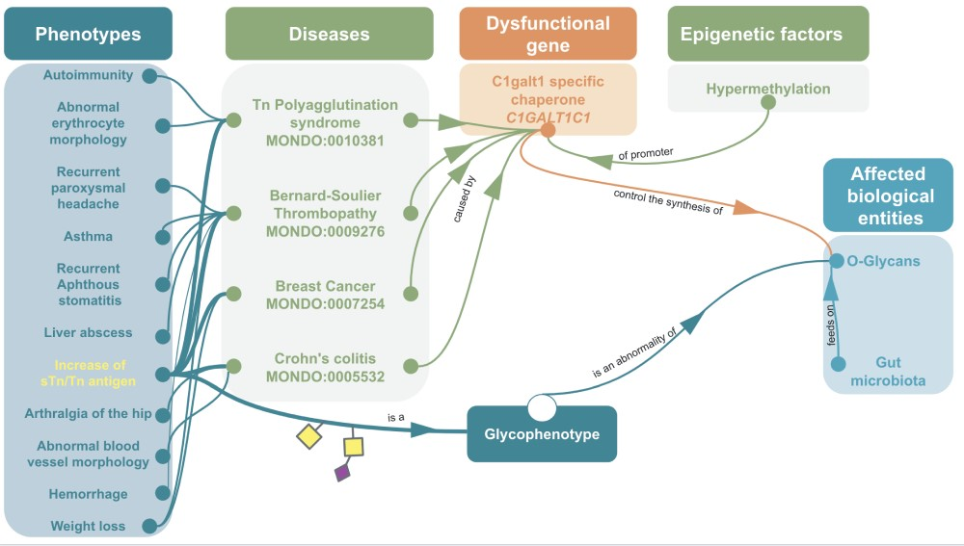
Figure 5 Example of omics integration with ontologies related to glycans: graph representation of the impact of a ...
Notes:
Figure 5 Example of omics integration with ontologies related to glycans: graph representation of the impact of a dysfunctional C1GALT1C1 on health C1GALT1C1 encodes Cosmc, a molecular chaperone for a glycosyltransferase that initiates O-GalNac glycans synthesis (T-synthase) (127). Dysfunctional Cosmc can lead to an improper T-synthase folding, thus abnormal O-glycans with the abnormal glycophenotype: increase of sTn/Tn antigen (SNFG symbols, respectively, yellow square for Tn and a purple diamond/yellow square for sTn) (128). Dysfunctional Cosmc (129) can be due to mutations or epigenetic factors, for instance the hypermethylation of C1GALT1C1’s promoter can lead to increase of sTn/Tn antigen. These two glycophenotypes are also common in many cancers (130). Mouse models have shown that C1GALT1C1 mutation can lead to abnormal O-glycans on platelets, generating bleeding disorders similar to Bernard-Soulier syndrome (MONDO:0009276) (131) Inflammatory bowel disease similar to Crohn’s Colitis (132) and abnormal microbiota (133). In fact, human gut microbiota (HGM) feeds on normal MUC2 glycans (134–136). Hence, the disruption of MUC2 glycosylation due to C1GALT1C1 mutation could potentially lead to microbiota and host physiology issue (137).
Unless provided in the caption above, the following copyright applies to the content of this slide: © The Author(s) 2019. Published by Oxford University Press.This is an Open Access article distributed under the terms of the Creative Commons Attribution License (http://creativecommons.org/licenses/by/4.0/), which permits unrestricted reuse, distribution, and reproduction in any medium, provided the original work is properly cited.

