Slide 1
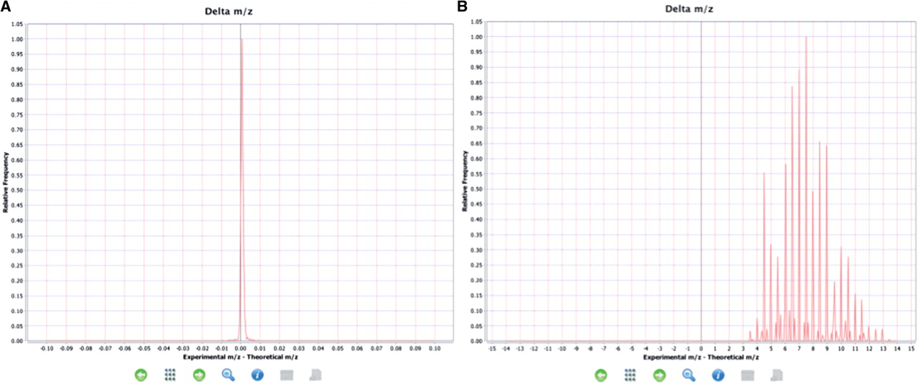
Figure 4. Examples of expected and unexpected delta m/z value distributions. (A) An expected delta m/z distribution ...
Notes:
Figure 4. Examples of expected and unexpected delta m/z value distributions. (A) An expected delta m/z distribution where the value are within the −4.0, +4.0 m/z units range. (B) Unexpected distribution of delta m/z values where most of the values are outside of the −4.0, +4.0 m/z units range indicating a potential problem.
Unless provided in the caption above, the following copyright applies to the content of this slide: © The Author(s) 2012. Published by Oxford University Press.This is an Open Access article distributed under the terms of the Creative Commons Attribution Non-Commercial License (http://creativecommons.org/licenses/by-nc/3.0), which permits unrestricted non-commercial use, distribution, and reproduction in any medium, provided the original work is properly cited.

