Slide 1
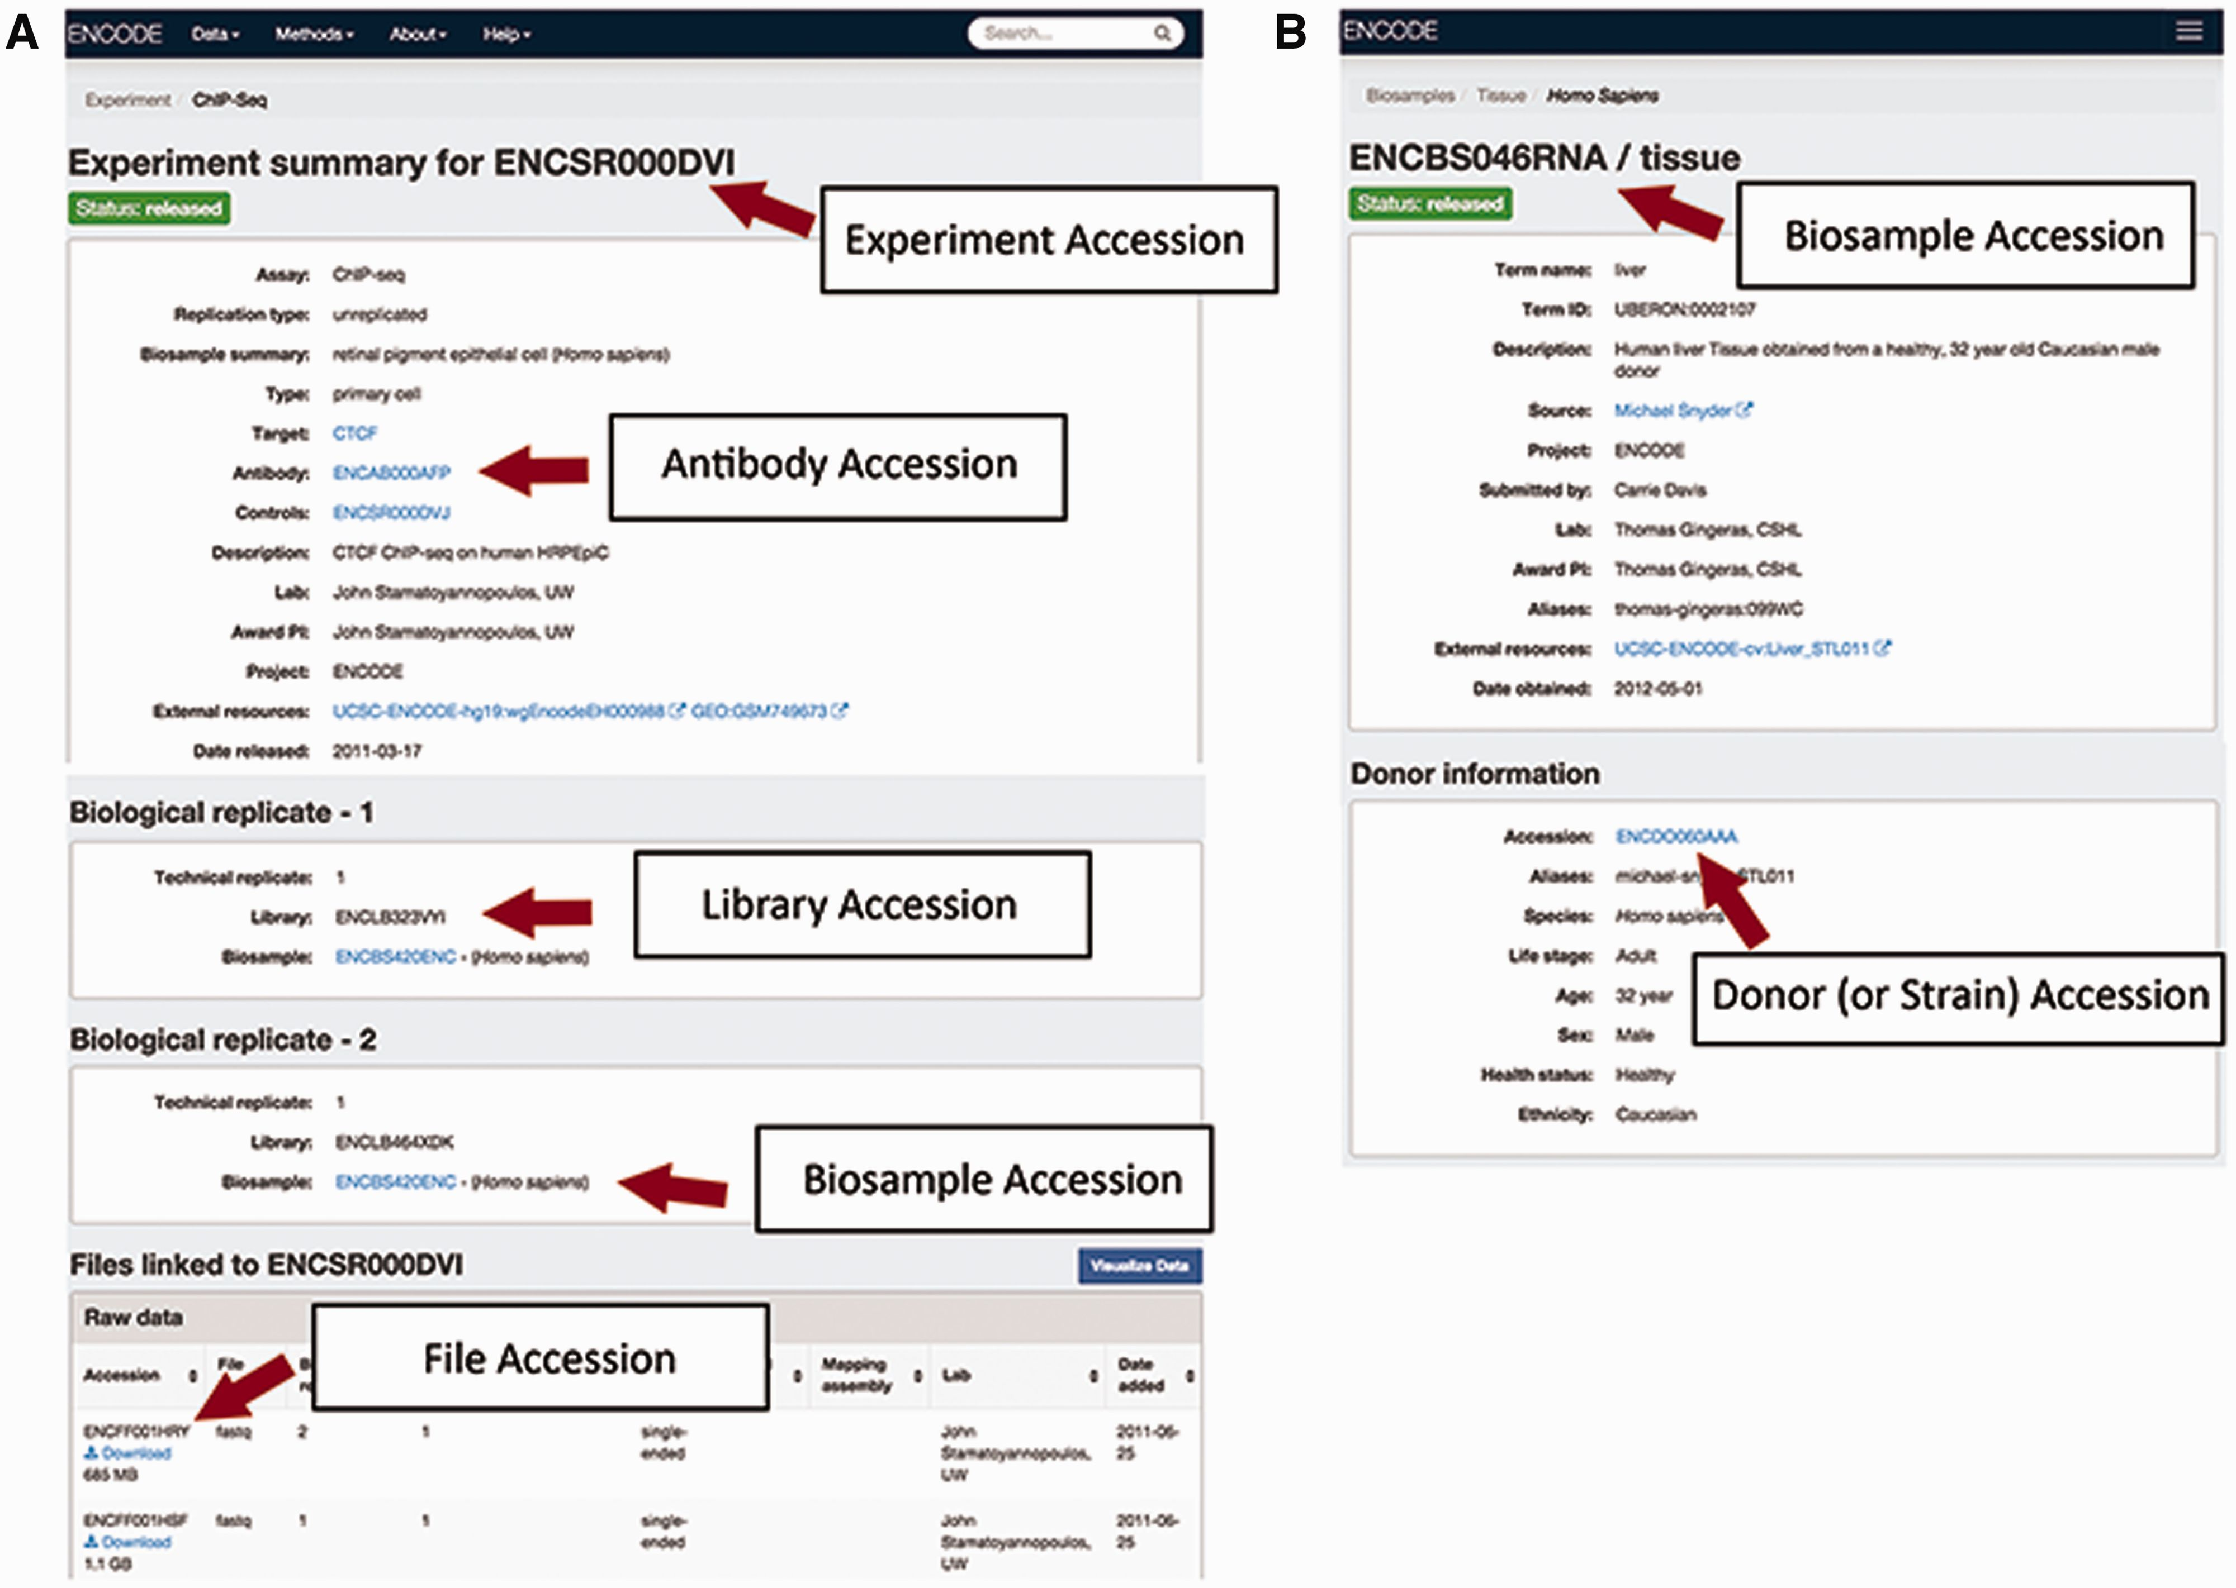
Figure 2 Accessions listed for an experiment on the ENCODE Portal. (A) An experiment page will contain accessions for ...
Notes:
Figure 2 Accessions listed for an experiment on the ENCODE Portal. (A) An experiment page will contain accessions for the experiment referring to the full set of metadata describing how the assay was performed and the data generated by the assay, for the specific antibody lot used in that experiment, for the library that was generated, for the biosample that was used as input to the experiment, and for each data file generated by sequencing. (B) A biosample page will contain accessions for the biosample that was used as well as the unique donor (or strain) that provided the sample.
Unless provided in the caption above, the following copyright applies to the content of this slide: © The Author(s) 2016. Published by Oxford University Press. This is an Open Access article distributed under the terms of the Creative Commons Attribution License ( http://creativecommons.org/licenses/by/4.0/ ), which permits unrestricted reuse, distribution, and reproduction in any medium, provided the original work is properly cited.

Slide 2
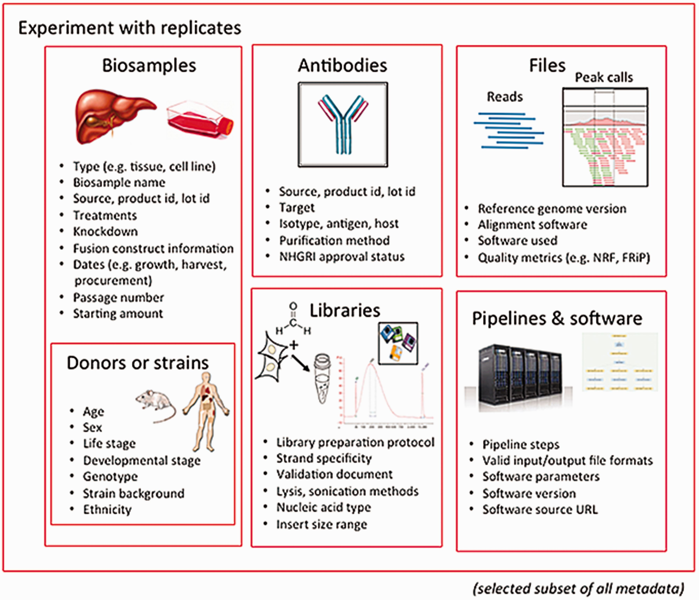
Figure 1 Major categories of metadata. The metadata captured for ENCODE can be grouped into the following major ...
Notes:
Figure 1 Major categories of metadata. The metadata captured for ENCODE can be grouped into the following major areas: biosamples and donors/strains (formerly ‘cell types’), libraries, antibodies, data files and pipelines and software. These categories are then grouped into an experiment with replicates. Only a subset of metadata is listed in the figure to provide an overview of the breadth and depth of metadata collected for an assay. The full set of metadata can be viewed at https://github.com/ENCODE-DCC/encoded/tree/master/src/encoded/schemas .
Unless provided in the caption above, the following copyright applies to the content of this slide: © The Author(s) 2016. Published by Oxford University Press. This is an Open Access article distributed under the terms of the Creative Commons Attribution License ( http://creativecommons.org/licenses/by/4.0/ ), which permits unrestricted reuse, distribution, and reproduction in any medium, provided the original work is properly cited.

Slide 3
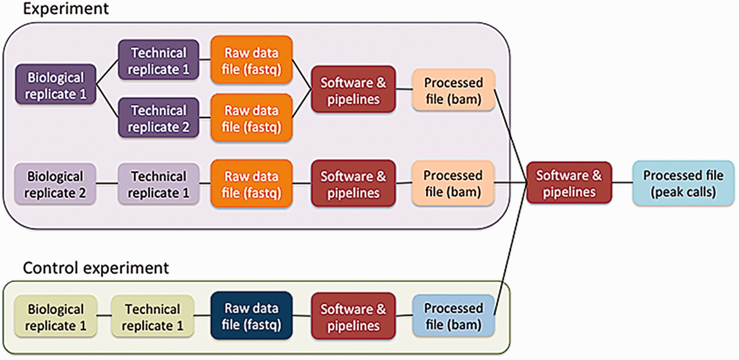
Figure 3 Schematic of the metadata model. The metadata model reflects how researchers perform laboratory and ...
Notes:
Figure 3 Schematic of the metadata model. The metadata model reflects how researchers perform laboratory and computational experiments. A single experiment can contain one or more replicates (see text). These replicates generate raw data files, which are then used in software and data processing pipelines to generate processed data files. Control experiments can be modeled similarly to experiments. Files from multiple experiments can be used as input for a single pipeline run.
Unless provided in the caption above, the following copyright applies to the content of this slide: © The Author(s) 2016. Published by Oxford University Press. This is an Open Access article distributed under the terms of the Creative Commons Attribution License ( http://creativecommons.org/licenses/by/4.0/ ), which permits unrestricted reuse, distribution, and reproduction in any medium, provided the original work is properly cited.

Slide 4
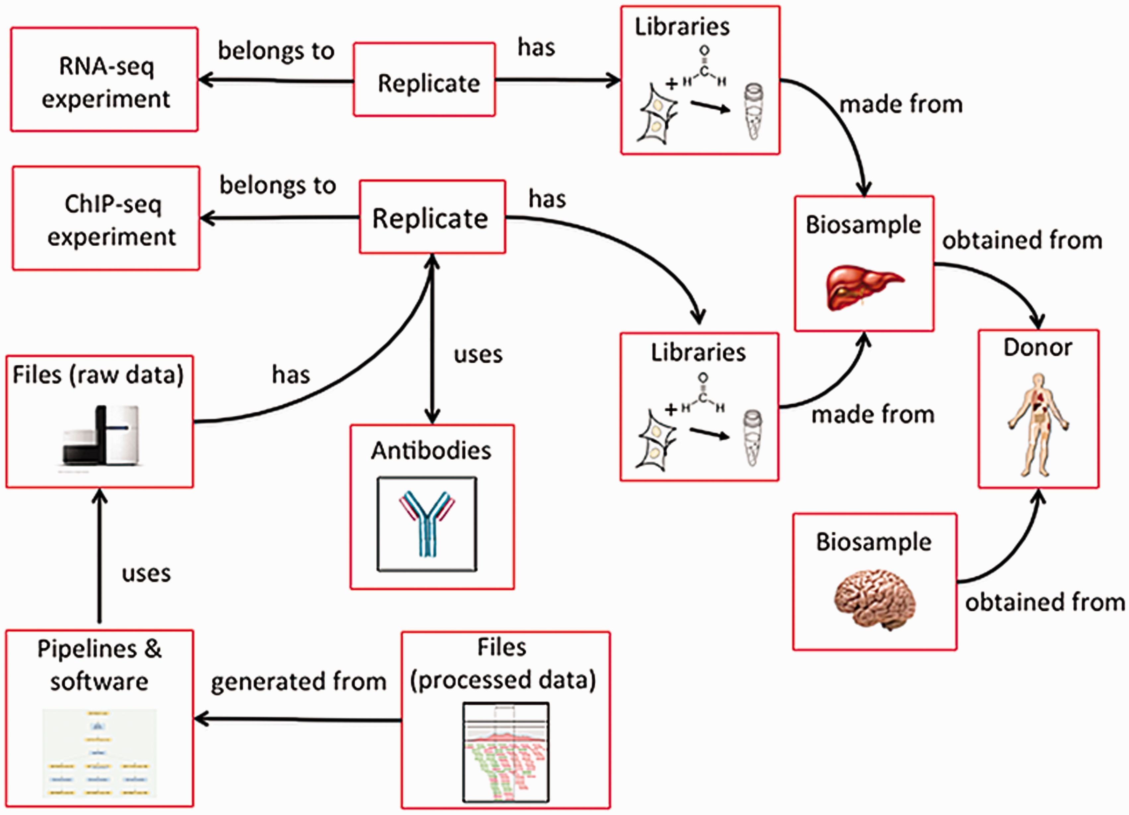
Figure 4 Categories in the metadata model are linked to each other. Categories of metadata are linked to each other ...
Notes:
Figure 4 Categories in the metadata model are linked to each other. Categories of metadata are linked to each other and can be described by relationships between the categories. Each individual category can be referred to multiple times. For example, a liver and a brain can be obtained from the same donor. In addition, a single biosample, like the liver, can be used as input for multiple assays. Because each donor and biosample is accessioned, they can be referred to uniquely.
Unless provided in the caption above, the following copyright applies to the content of this slide: © The Author(s) 2016. Published by Oxford University Press. This is an Open Access article distributed under the terms of the Creative Commons Attribution License ( http://creativecommons.org/licenses/by/4.0/ ), which permits unrestricted reuse, distribution, and reproduction in any medium, provided the original work is properly cited.

Slide 5
Figure 6 Metadata validation in the schema. The schema allows dependencies which allow conditions to be defined on ...
Notes:
Figure 6 Metadata validation in the schema. The schema allows dependencies which allow conditions to be defined on which set of data should be submitted. In this example, the dependency states that the paired files from paired-end sequencing runs need to be explicitly defined. This prevents paired-end files from being separated from each other as the data are submitted.
Unless provided in the caption above, the following copyright applies to the content of this slide: © The Author(s) 2016. Published by Oxford University Press. This is an Open Access article distributed under the terms of the Creative Commons Attribution License ( http://creativecommons.org/licenses/by/4.0/ ), which permits unrestricted reuse, distribution, and reproduction in any medium, provided the original work is properly cited.

Slide 6
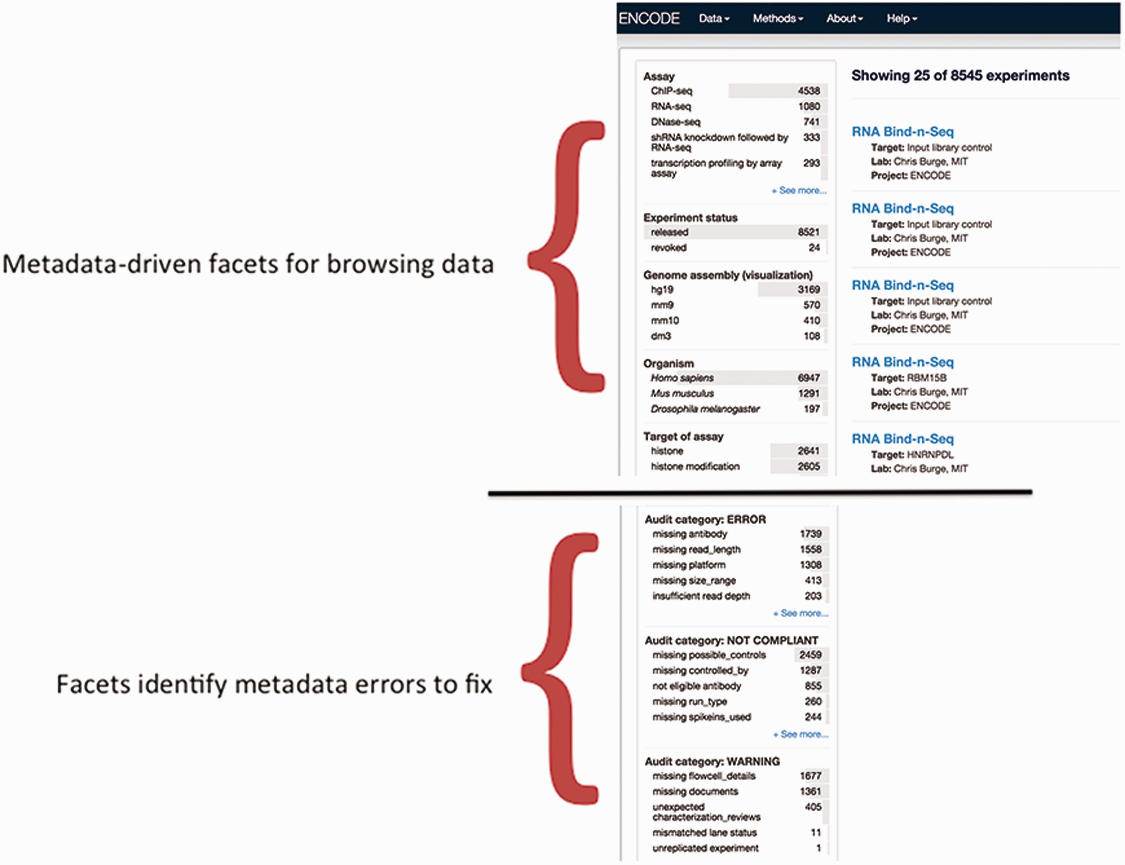
Figure 7 Validation of metadata using audits. The top half of the panel is a screenshot of the metadata-drive facets ...
Notes:
Figure 7 Validation of metadata using audits. The top half of the panel is a screenshot of the metadata-drive facets that can be used for browsing data. The bottom panel is a screenshot of a data audit that is visible to data submitters and the DCC. It includes a list of queries that are performed for inconsistent or incorrect metadata. These audits ensure that the metadata are accurate before data release.
Unless provided in the caption above, the following copyright applies to the content of this slide: © The Author(s) 2016. Published by Oxford University Press. This is an Open Access article distributed under the terms of the Creative Commons Attribution License ( http://creativecommons.org/licenses/by/4.0/ ), which permits unrestricted reuse, distribution, and reproduction in any medium, provided the original work is properly cited.

Slide 7
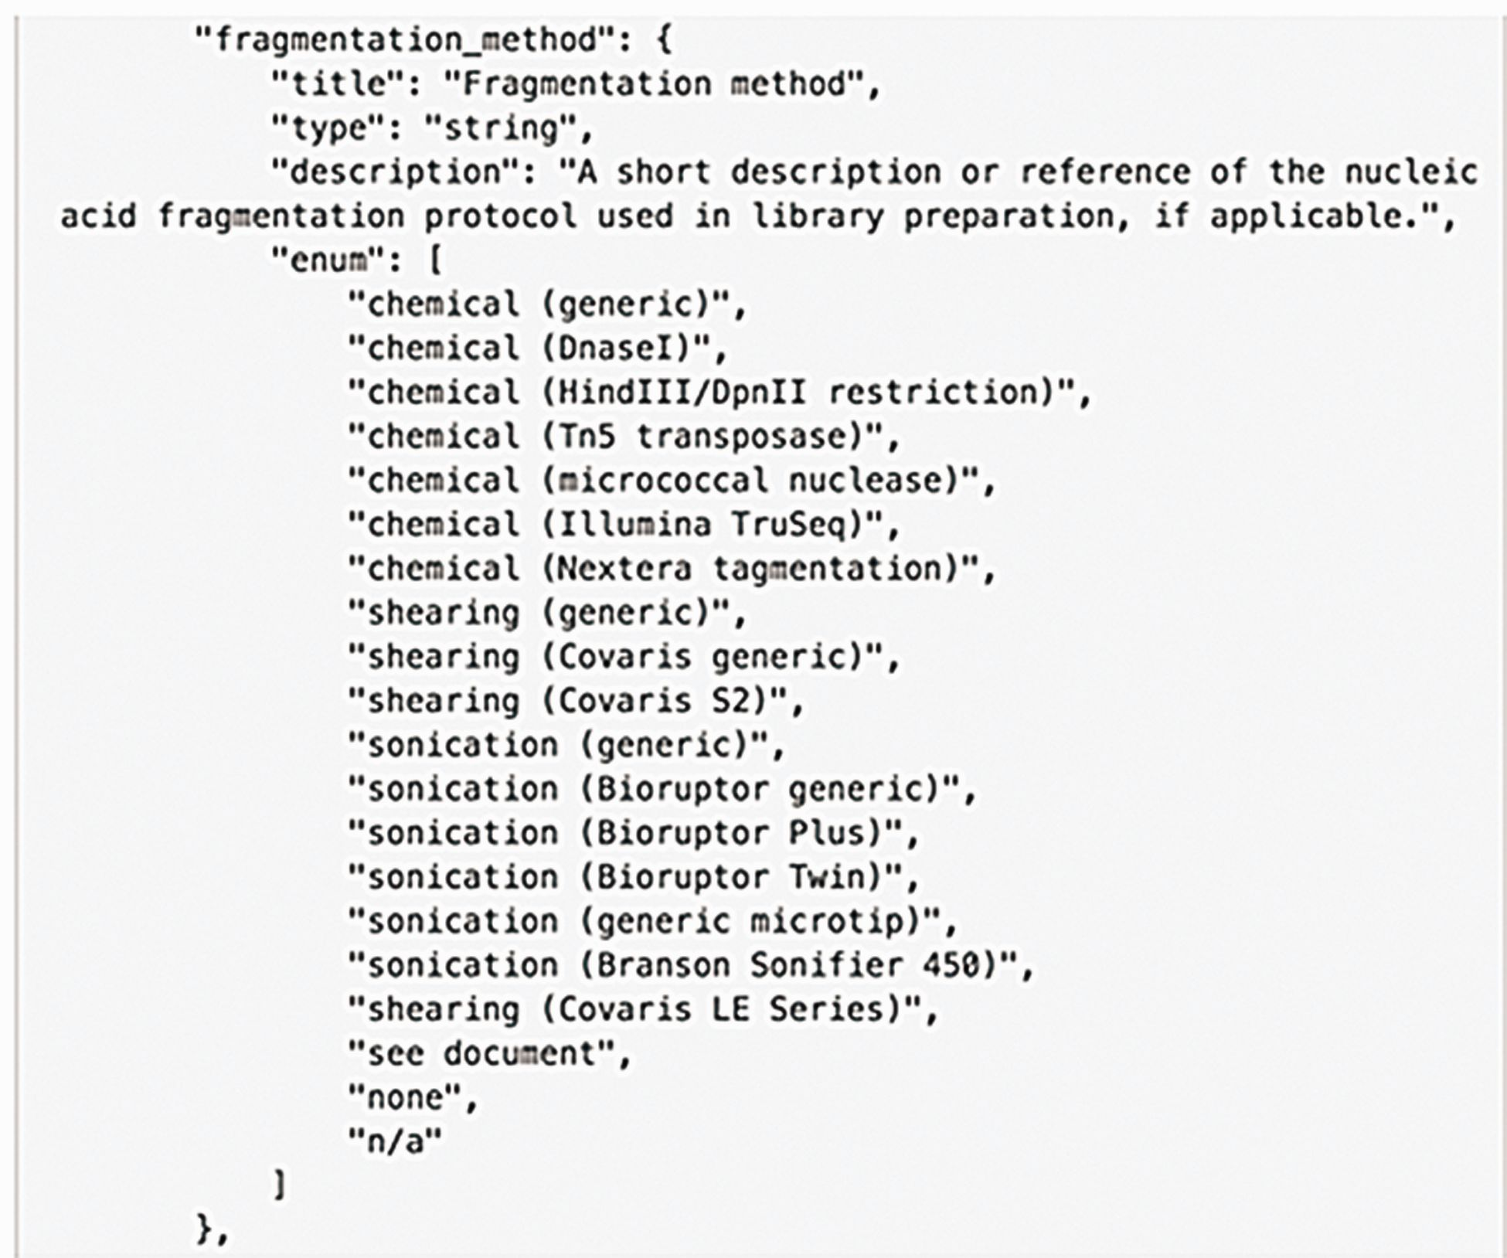
Figure 5 Example of an enumerated list in the schema. The metadata model is represented as a JSON object (this ...
Notes:
Figure 5 Example of an enumerated list in the schema. The metadata model is represented as a JSON object (this computational structure is the metadata data model) containing properties of specific metadata fields. An enumerated list is a list of allowed values for that property. It prevents typos or multiple spellings of a single item to maintain consistent data. Values added for this property are checked against the list when the data are added.
Unless provided in the caption above, the following copyright applies to the content of this slide: © The Author(s) 2016. Published by Oxford University Press. This is an Open Access article distributed under the terms of the Creative Commons Attribution License ( http://creativecommons.org/licenses/by/4.0/ ), which permits unrestricted reuse, distribution, and reproduction in any medium, provided the original work is properly cited.

