Slide 1
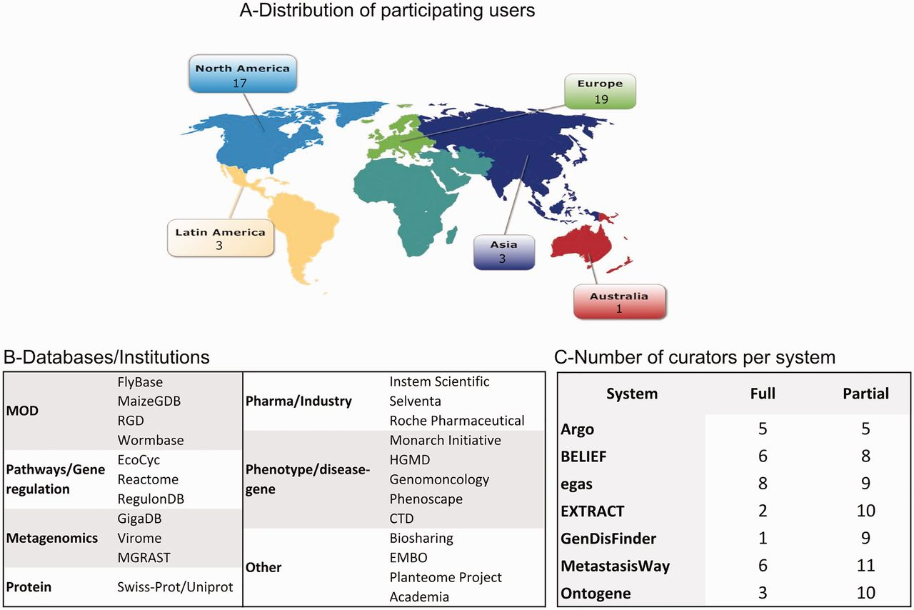
Figure 1. Distribution of biocurators (A) by geographic area, (B) by type of database/institution, and (C) by level of ...
Notes:
Figure 1. Distribution of biocurators (A) by geographic area, (B) by type of database/institution, and (C) by level of participation. A total of 43 biocurators participated in this activity. Notice that the total number in (C) is higher because some biocurators tested more than one system, and all curators participated in the partial activity.
Unless provided in the caption above, the following copyright applies to the content of this slide: Published by Oxford University Press 2016. This work is written by US Government employees and is in the public domain in the US.

Slide 2
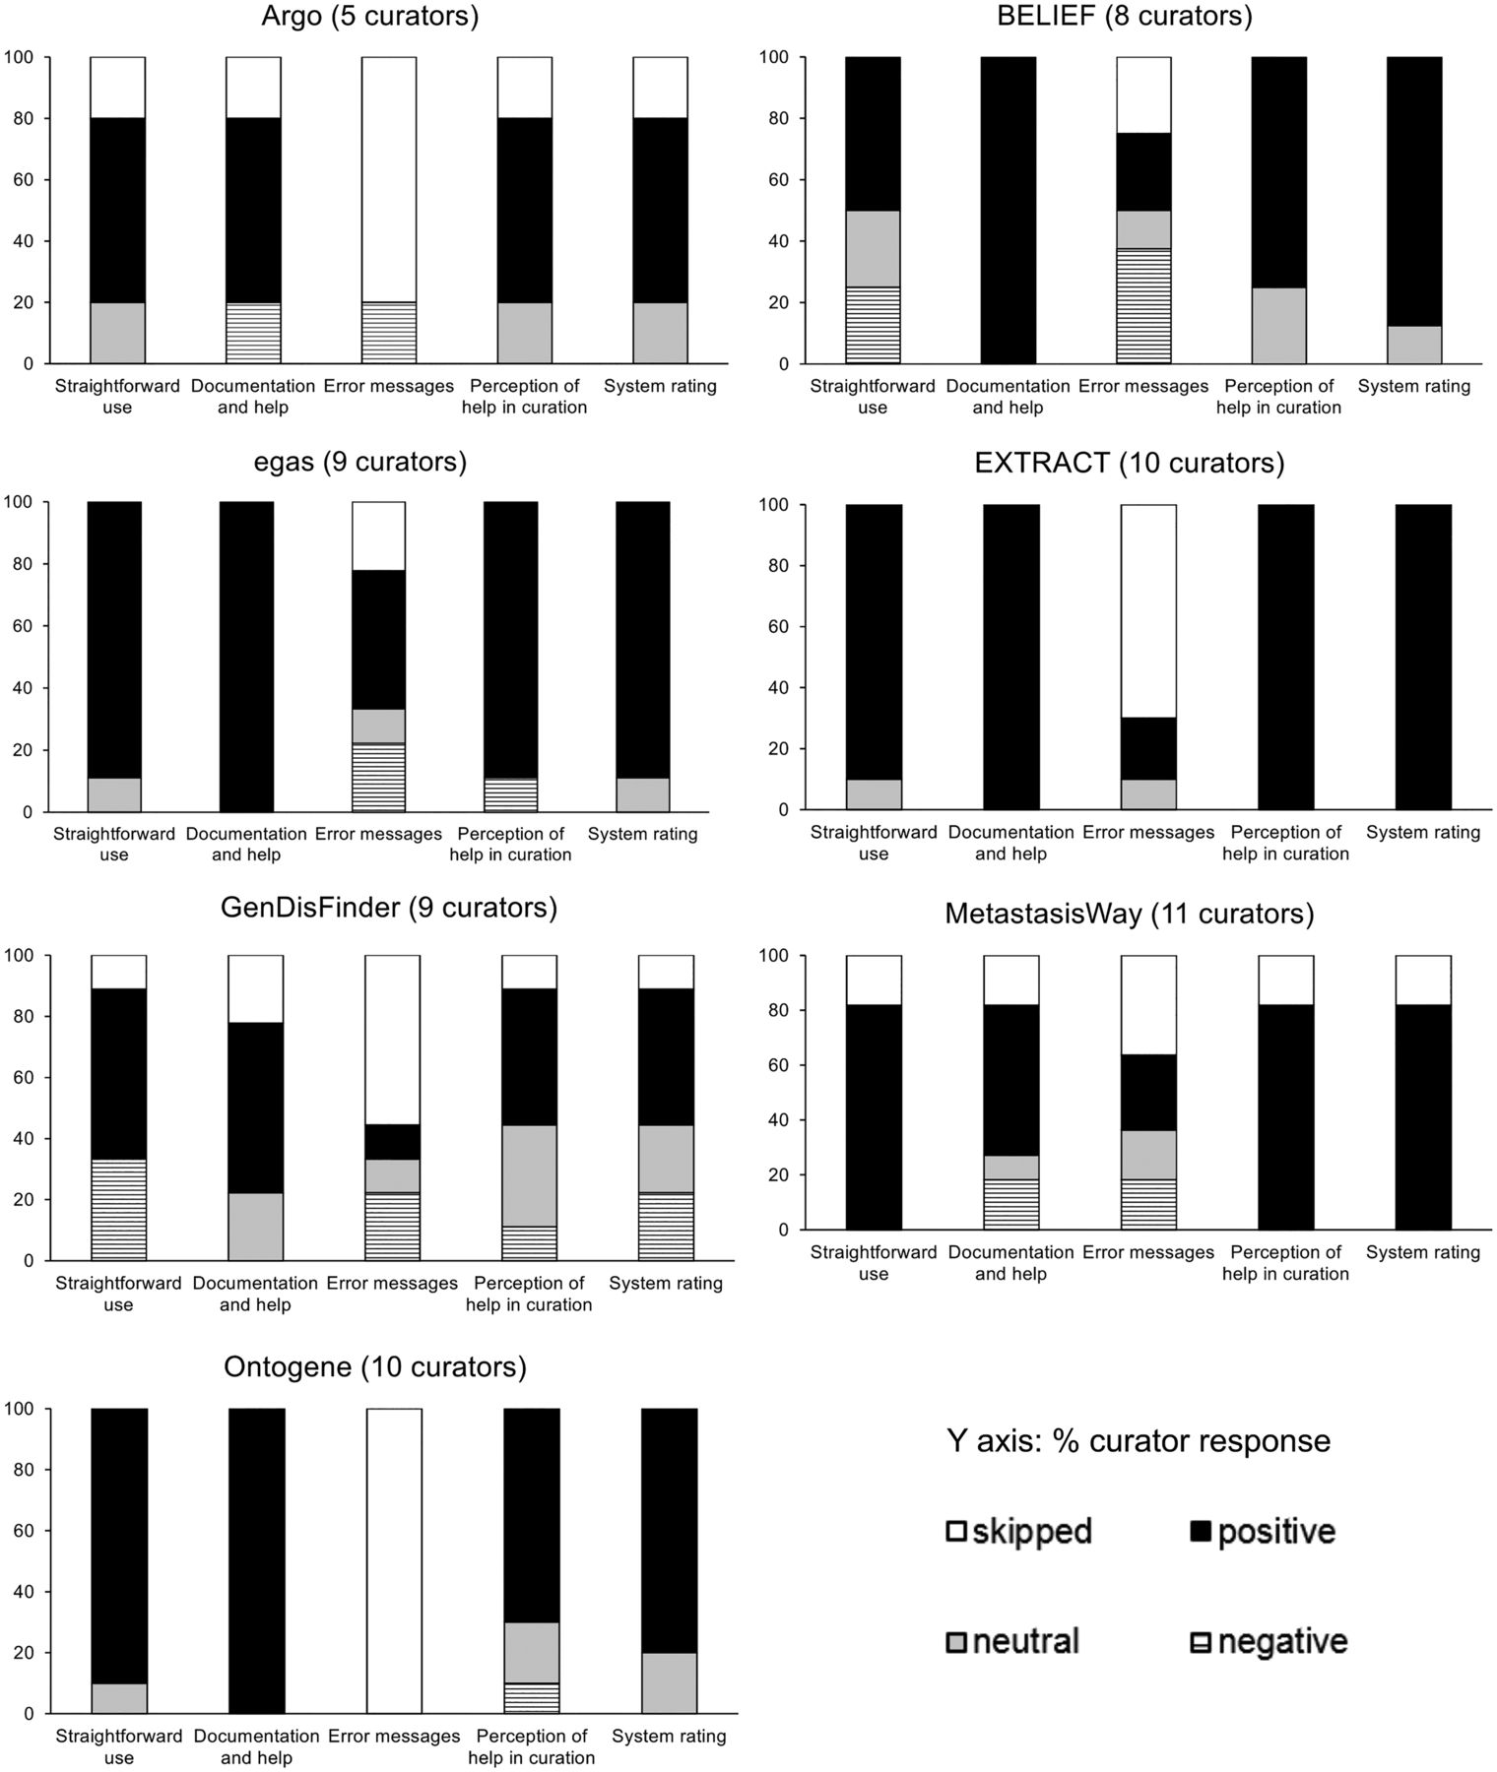
Figure 2. Pooled responses to questions related to system perception of usability from the pre-designed task activity.
Notes:
Figure 2. Pooled responses to questions related to system perception of usability from the pre-designed task activity.
Unless provided in the caption above, the following copyright applies to the content of this slide: Published by Oxford University Press 2016. This work is written by US Government employees and is in the public domain in the US.

Slide 3
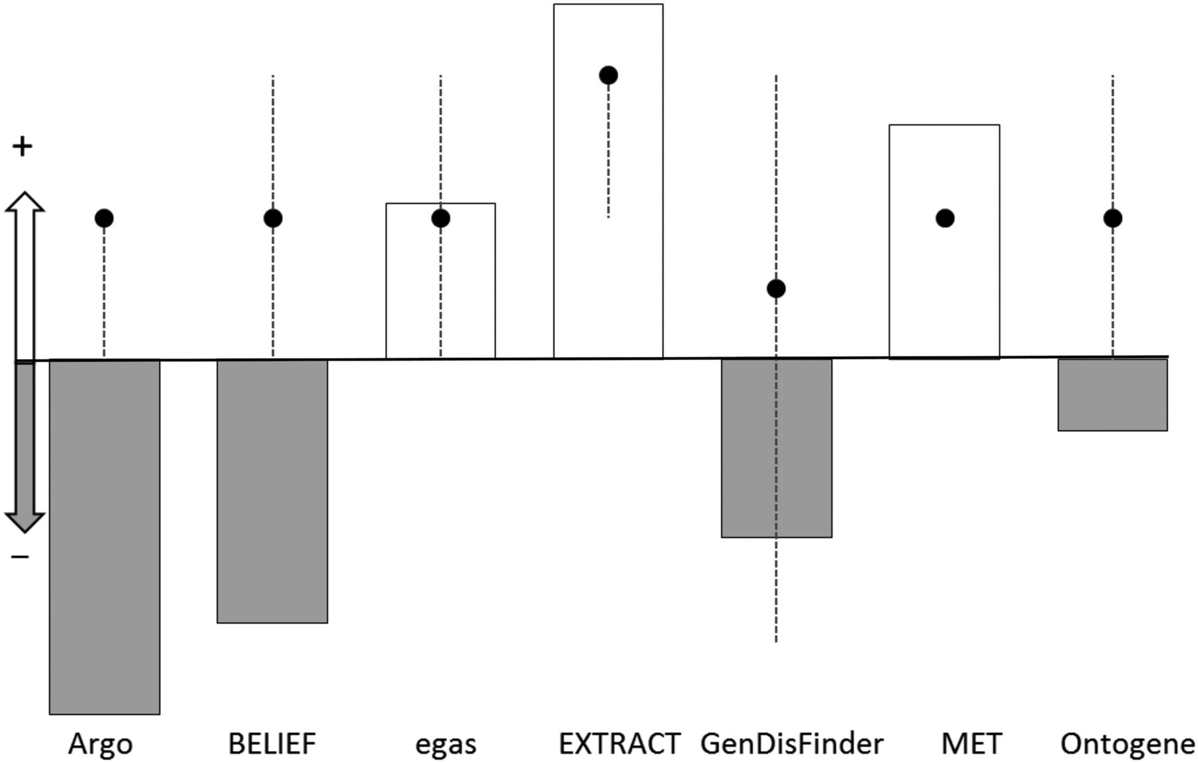
Figure 3. Plot of the NPS score (bars) and the median for the system rating for each system (dots). The y-axis ...
Notes:
Figure 3. Plot of the NPS score (bars) and the median for the system rating for each system (dots). The y-axis represents whether the NPS and median are positive (for NPS, positive means NPS > 0, for system rating median >3) or negative (for NPS, negative means NPS < 0, for system rating median <3). The NPS score is represented with bars, white and grey color indicate positive and negative scores, respectively. The median for the system rating is represented with black dots with dotted line extending from minimum to maximum value for the sample.
Unless provided in the caption above, the following copyright applies to the content of this slide: Published by Oxford University Press 2016. This work is written by US Government employees and is in the public domain in the US.

Slide 4
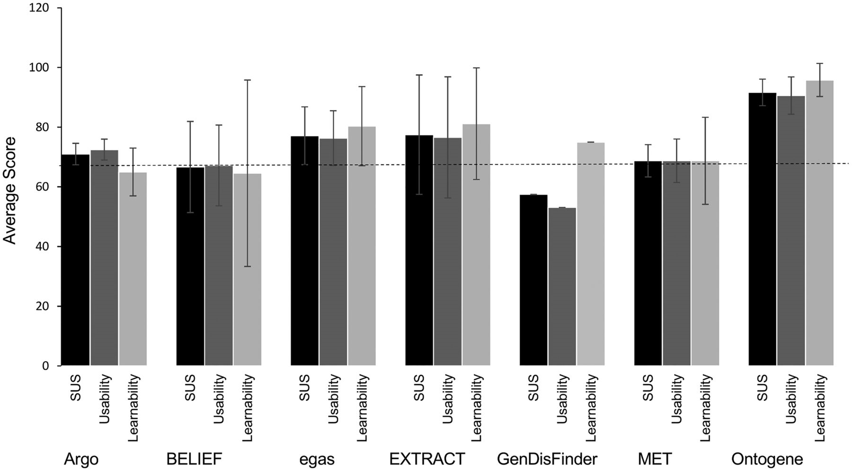
Figure 4. Scores for usability and learnability for each system. SUS score (black) encompasses 10 standard questions, ...
Notes:
Figure 4. Scores for usability and learnability for each system. SUS score (black) encompasses 10 standard questions, question 4 and 10 are related to learnability (light grey) where the others to usability (dark grey). Standard deviations are shown. The dashed line indicates the average SUS 68.
Unless provided in the caption above, the following copyright applies to the content of this slide: Published by Oxford University Press 2016. This work is written by US Government employees and is in the public domain in the US.

Slide 5
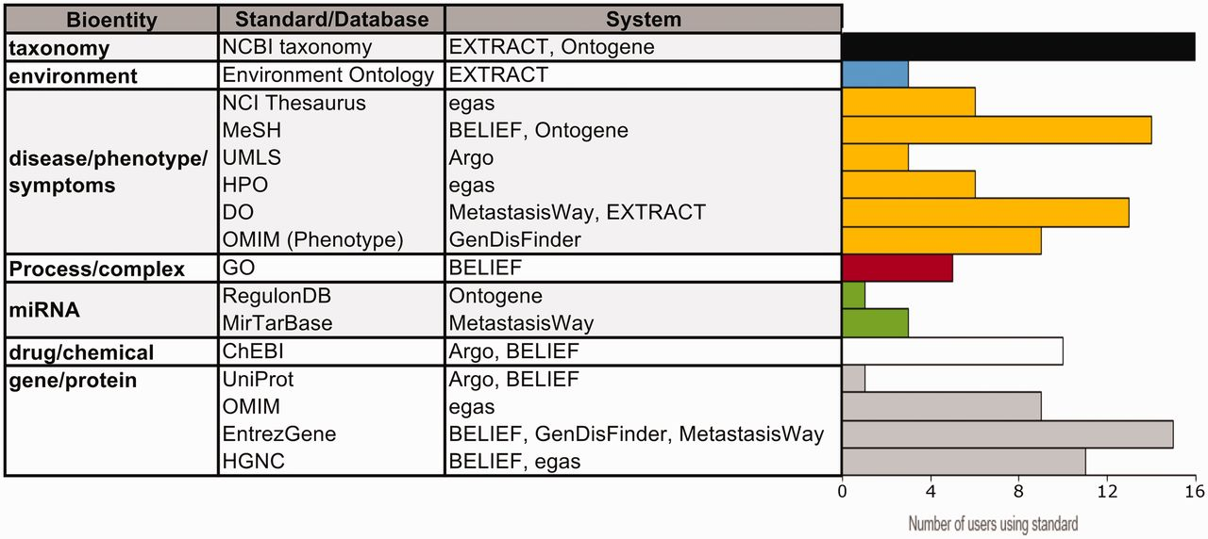
Figure 5. Usage of standards/databases proposed by the systems. The table describes most of the bioentities and ...
Notes:
Figure 5. Usage of standards/databases proposed by the systems. The table describes most of the bioentities and standards/databases proposed by the different systems, and the bar graphs show the number of IAT evaluators using each standard/database. Note that environment is a specialized bioentity type which is only used by the microbial and metagenomics communities. Data from 25 users.
Unless provided in the caption above, the following copyright applies to the content of this slide: Published by Oxford University Press 2016. This work is written by US Government employees and is in the public domain in the US.

