Slide 1
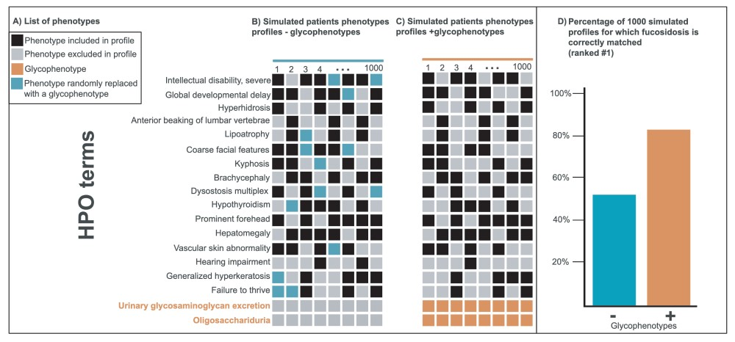
Figure 3 Improvement of disease diagnostic with molecular glycophenotypes for fucosidosis. Panel A lists 18 phenotypes ...
Notes:
Figure 3 Improvement of disease diagnostic with molecular glycophenotypes for fucosidosis. Panel A lists 18 phenotypes frequently associated with fucosidosis. The columns in Panels B and C illustrate simulated patients phenotypes profiles composed of a random selection of 10 of these 16 phenotypes. The profiles in Panel C include glycophenotypes (bottom in orange), whereas those in Panel B do not. Panel D shows that when these two groups of 1000 simulated profiles are compared for their diagnostic utility, the profiles that contain glycophenotypes (C) significantly outperform those that do not (B) (Fisher exact P-value = 8.5e-47). Moreover, more specific glycophenotypes are more diagnostically useful than more general ones. This underscores the importance of harmonizing glycophenotypes across data resources as well as collecting them from patients.
Unless provided in the caption above, the following copyright applies to the content of this slide: © The Author(s) 2019. Published by Oxford University Press.This is an Open Access article distributed under the terms of the Creative Commons Attribution License (http://creativecommons.org/licenses/by/4.0/), which permits unrestricted reuse, distribution, and reproduction in any medium, provided the original work is properly cited.

