Slide 1
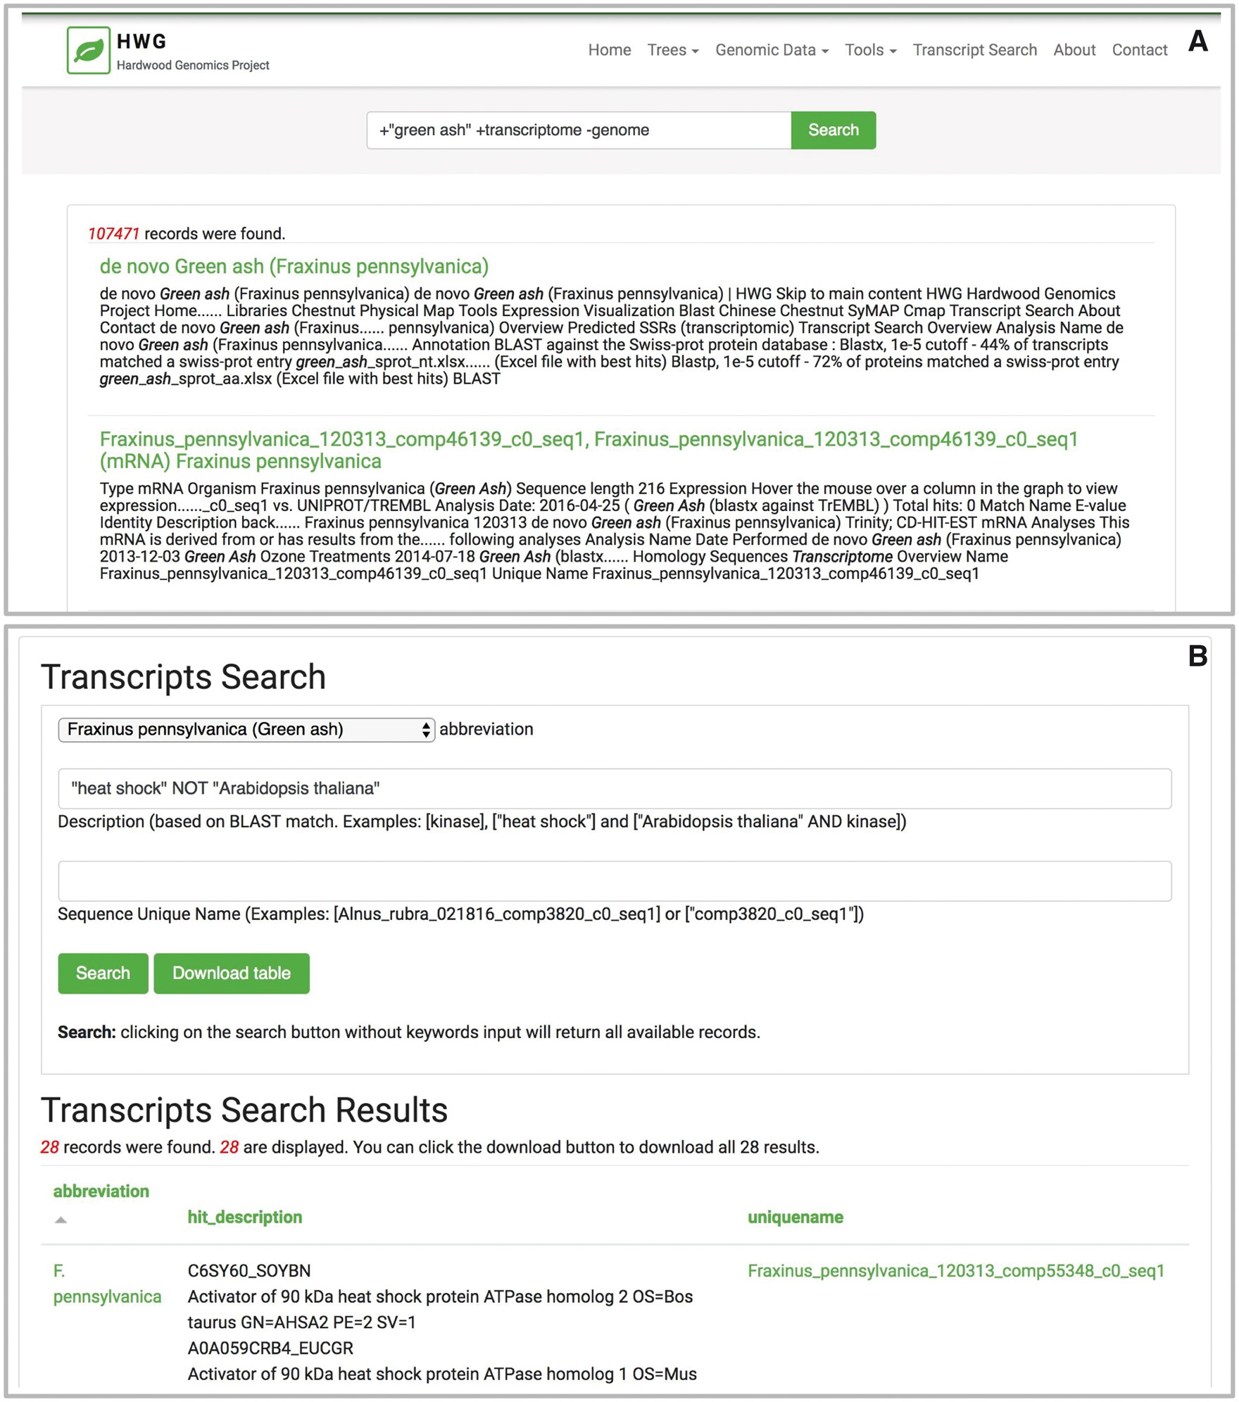
Figure 3. The Tripal Elasticsearch module builds content blocks for search forms. Using the Drupal block system, a ...
Notes:
Figure 3. The Tripal Elasticsearch module builds content blocks for search forms. Using the Drupal block system, a search block may be displayed on every page, on its own dedicated page or on a specific page or pages across the site. Screenshots are taken from the Hardwood Genomics Web where the Tripal Elasticsearch module is in production use. (A) The generic site-wide search block includes a single, global search field and search button. (B) A table-specific search form provides additional search fields for more advanced filtering of results. Here, transcript results are quickly returned from a database containing over 500 000 transcript records and >13 600 000 BLAST hits.
Unless provided in the caption above, the following copyright applies to the content of this slide: © The Author(s) 2017. Published by Oxford University Press.This is an Open Access article distributed under the terms of the Creative Commons Attribution License (http://creativecommons.org/licenses/by/4.0/), which permits unrestricted reuse, distribution, and reproduction in any medium, provided the original work is properly cited.

