Slide 1
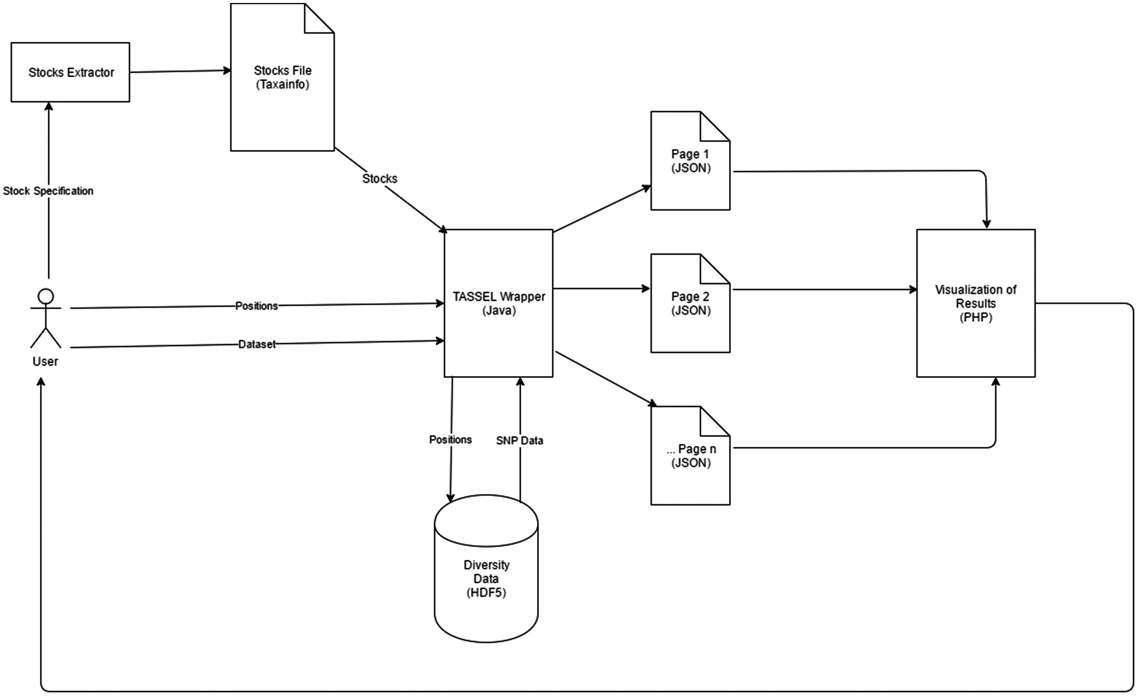
Figure 1. High level workflow and technical overview of SNPversity components. Users interact with the drop-down menus ...
Notes:
Figure 1. High level workflow and technical overview of SNPversity components. Users interact with the drop-down menus and enter their choices through the SNPversity home page. The necessary data, such as stocks information are pulled and feed into a TASSEL-based wrapper. The wrapper first queries diversity data stored in the HDF5 representation. The wrapper then creates appropriate JSON files for the PHP layer to visualize the data online.
Unless provided in the caption above, the following copyright applies to the content of this slide: Published by Oxford University Press 2018. This work is written by US Government employees and is in the public domain in the US.This article is published and distributed under the terms of the Oxford University Press, Standard Journals Publication Model (https://academic.oup.com/journals/pages/about_us/legal/notices)

