Slide 1
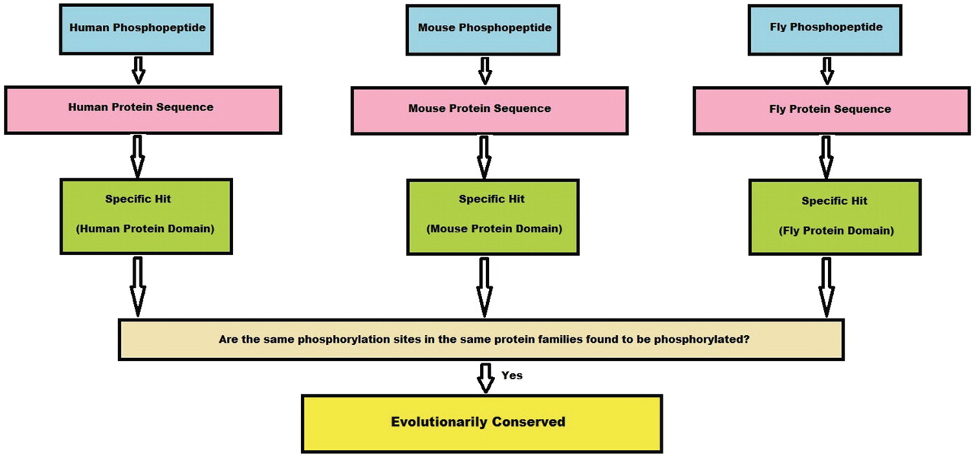
Figure 3. Algorithm flowchart. This flowchart explains in brief how a conserved site is obtained from the experimental ...
Notes:
Figure 3. Algorithm flowchart. This flowchart explains in brief how a conserved site is obtained from the experimental phosphopeptide data sets from three species. First, a phosphopeptide is mapped to its protein sequence and later onto specific hits, if any. If the phosphosites from these three species map to the same position on the specific hit, we consider the site to be conserved.
Unless provided in the caption above, the following copyright applies to the content of this slide: Published by Oxford University Press 2011.This is Open Access article distributed under the terms of the Creative Commons Attribution Non-Commercial License (http://creativecommons.org/licenses/by-nc/2.5), which permits unrestricted non-commercial use, distribution, and reproduction in any medium, provided the original work is properly cited.

