Slide 1
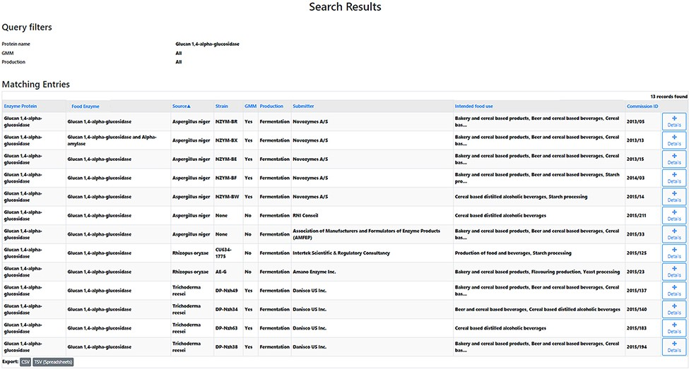
Figure 3. Search results research question 5.1. A list of 13 records is obtained. The table headers can be used to ...
Notes:
Figure 3. Search results research question 5.1. A list of 13 records is obtained. The table headers can be used to filter the obtained results. By selecting the ‘Details’ icon, the user is redirected to the detailed information of the selected FE. From those pages, amongst others, the EFSA status can be collected.
Unless provided in the caption above, the following copyright applies to the content of this slide: © The Author(s) 2021. Published by Oxford University Press.This is an Open Access article distributed under the terms of the Creative Commons Attribution License (https://creativecommons.org/licenses/by/4.0/), which permits unrestricted reuse, distribution, and reproduction in any medium, provided the original work is properly cited.

