Slide 1
Figure 1. An example drawn from the DrugProt data set, showing a sentence with an INHIBITOR relation between a ...
Notes:
Figure 1. An example drawn from the DrugProt data set, showing a sentence with an INHIBITOR relation between a chemical/drug entity (the subject, Caffeine) and a gene/protein entity (the object, kinase).
Unless provided in the caption above, the following copyright applies to the content of this slide: © The Author(s) 2022. Published by Oxford University Press.This is an Open Access article distributed under the terms of the Creative Commons Attribution-NonCommercial License (https://creativecommons.org/licenses/by-nc/4.0/), which permits non-commercial re-use, distribution, and reproduction in any medium, provided the original work is properly cited. For commercial re-use, please contact journals.permissions@oup.com

Slide 2
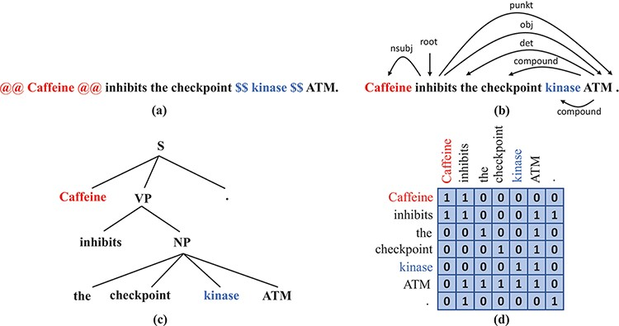
Figure 2. Syntax representations that we obtain from off-the-shelf parsers: (a) A sentence with the subject and the ...
Notes:
Figure 2. Syntax representations that we obtain from off-the-shelf parsers: (a) A sentence with the subject and the object wrapped by markers. (b) The dependency tree of the sentence in (a). (c) The constituency tree of the sentence in (a). (d) The adjacency matrix that corresponds to the dependency tree in (b).
Unless provided in the caption above, the following copyright applies to the content of this slide: © The Author(s) 2022. Published by Oxford University Press.This is an Open Access article distributed under the terms of the Creative Commons Attribution-NonCommercial License (https://creativecommons.org/licenses/by-nc/4.0/), which permits non-commercial re-use, distribution, and reproduction in any medium, provided the original work is properly cited. For commercial re-use, please contact journals.permissions@oup.com

Slide 3
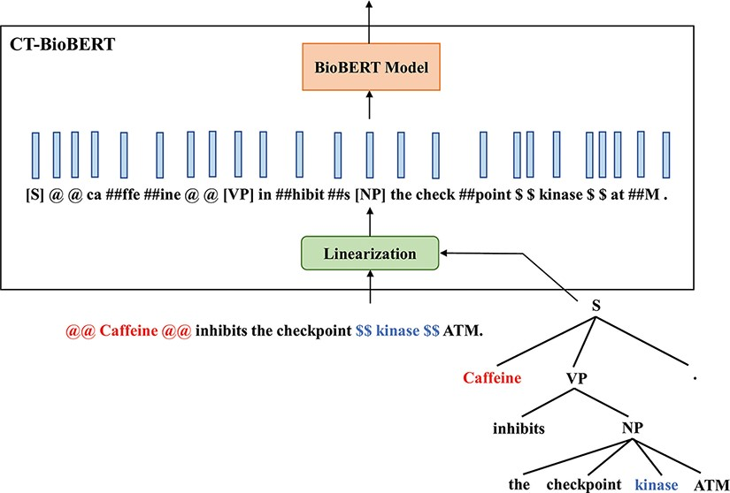
Figure 4. Diagram illustrating the architecture of CT-BioBERT: linearized constituency trees are fed into the BioBERT ...
Notes:
Figure 4. Diagram illustrating the architecture of CT-BioBERT: linearized constituency trees are fed into the BioBERT model, and each BERT layer shares the same subtree mask.
Unless provided in the caption above, the following copyright applies to the content of this slide: © The Author(s) 2022. Published by Oxford University Press.This is an Open Access article distributed under the terms of the Creative Commons Attribution-NonCommercial License (https://creativecommons.org/licenses/by-nc/4.0/), which permits non-commercial re-use, distribution, and reproduction in any medium, provided the original work is properly cited. For commercial re-use, please contact journals.permissions@oup.com

Slide 4
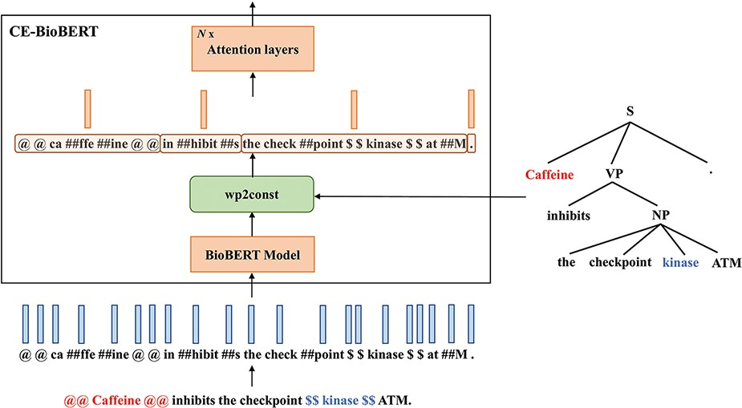
Figure 3. Diagram illustrating the architecture of CE-BioBERT: the wp2const block at the output of the BioBERT model ...
Notes:
Figure 3. Diagram illustrating the architecture of CE-BioBERT: the wp2const block at the output of the BioBERT model groups together the wordpieces that belong to a pre-defined chunk to compute chunk embeddings.
Unless provided in the caption above, the following copyright applies to the content of this slide: © The Author(s) 2022. Published by Oxford University Press.This is an Open Access article distributed under the terms of the Creative Commons Attribution-NonCommercial License (https://creativecommons.org/licenses/by-nc/4.0/), which permits non-commercial re-use, distribution, and reproduction in any medium, provided the original work is properly cited. For commercial re-use, please contact journals.permissions@oup.com

Slide 5
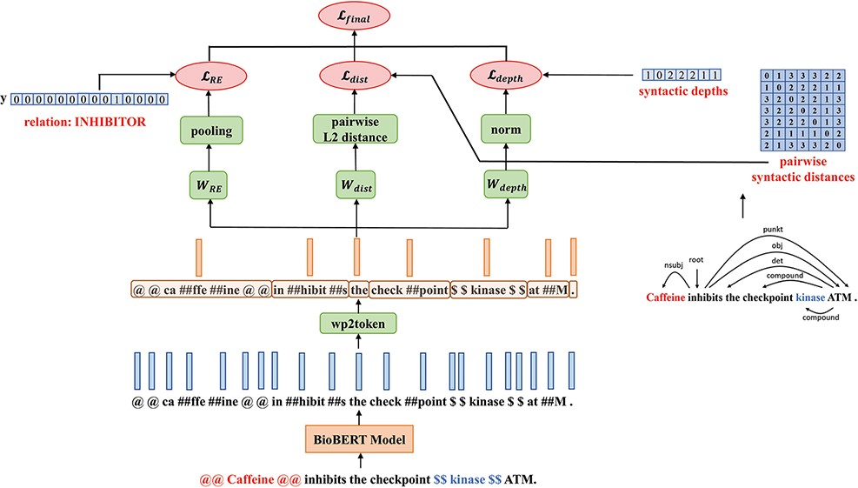
Figure 5. The architecture of MTS-BioBERT: Besides the relation label, for the two probing tasks, we compute pairwise ...
Notes:
Figure 5. The architecture of MTS-BioBERT: Besides the relation label, for the two probing tasks, we compute pairwise syntactic distance matrices and syntactic depths from dependency trees obtained from a syntactic parser.
Unless provided in the caption above, the following copyright applies to the content of this slide: © The Author(s) 2022. Published by Oxford University Press.This is an Open Access article distributed under the terms of the Creative Commons Attribution-NonCommercial License (https://creativecommons.org/licenses/by-nc/4.0/), which permits non-commercial re-use, distribution, and reproduction in any medium, provided the original work is properly cited. For commercial re-use, please contact journals.permissions@oup.com

Slide 6
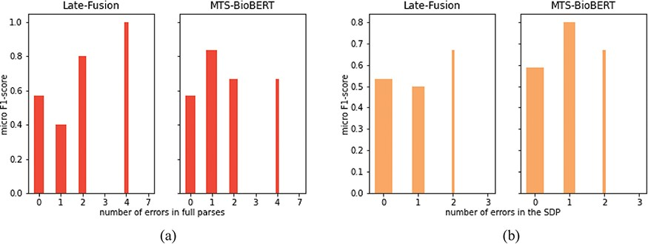
Figure 6. RE performance on the subset of sentences used for manual dependency analysis: (a) stratified by the number ...
Notes:
Figure 6. RE performance on the subset of sentences used for manual dependency analysis: (a) stratified by the number of erroneous dependency links identified in full parses and (b) stratified by the number of erroneous dependency links in SDPs.
Unless provided in the caption above, the following copyright applies to the content of this slide: © The Author(s) 2022. Published by Oxford University Press.This is an Open Access article distributed under the terms of the Creative Commons Attribution-NonCommercial License (https://creativecommons.org/licenses/by-nc/4.0/), which permits non-commercial re-use, distribution, and reproduction in any medium, provided the original work is properly cited. For commercial re-use, please contact journals.permissions@oup.com

Slide 7
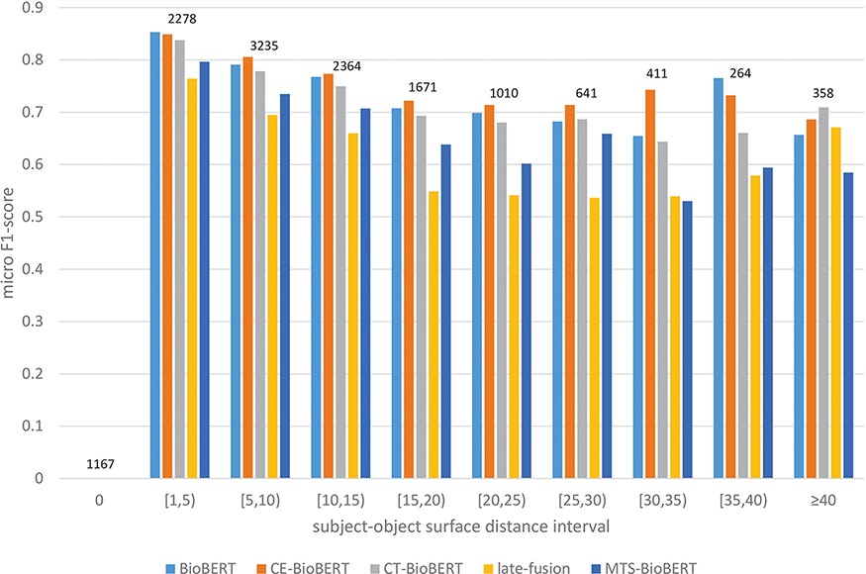
Figure 7. Stratified results on DrugProt validation set: Examples in the validation set are regrouped based on their ...
Notes:
Figure 7. Stratified results on DrugProt validation set: Examples in the validation set are regrouped based on their subject–object surface distances. Intervals are of length 5 except two special cases 0 and $ \ge $40. For each interval, the number of examples that fall in this interval is shown on top of bars.
Unless provided in the caption above, the following copyright applies to the content of this slide: © The Author(s) 2022. Published by Oxford University Press.This is an Open Access article distributed under the terms of the Creative Commons Attribution-NonCommercial License (https://creativecommons.org/licenses/by-nc/4.0/), which permits non-commercial re-use, distribution, and reproduction in any medium, provided the original work is properly cited. For commercial re-use, please contact journals.permissions@oup.com

Slide 8
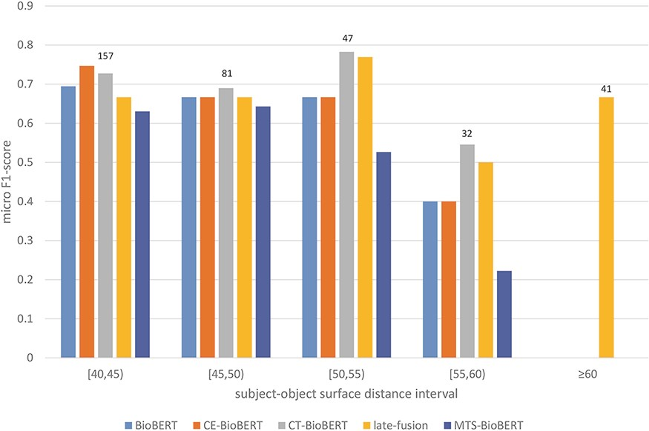
Figure 8. Stratified results on the DrugProt validation set (surface distance $ \ge $40): Examples in the validation ...
Notes:
Figure 8. Stratified results on the DrugProt validation set (surface distance $ \ge $40): Examples in the validation set are regrouped based on their subject–object surface distances. For each interval, the number of examples that fall in this interval is shown on top of the bars.
Unless provided in the caption above, the following copyright applies to the content of this slide: © The Author(s) 2022. Published by Oxford University Press.This is an Open Access article distributed under the terms of the Creative Commons Attribution-NonCommercial License (https://creativecommons.org/licenses/by-nc/4.0/), which permits non-commercial re-use, distribution, and reproduction in any medium, provided the original work is properly cited. For commercial re-use, please contact journals.permissions@oup.com

