Slide 1
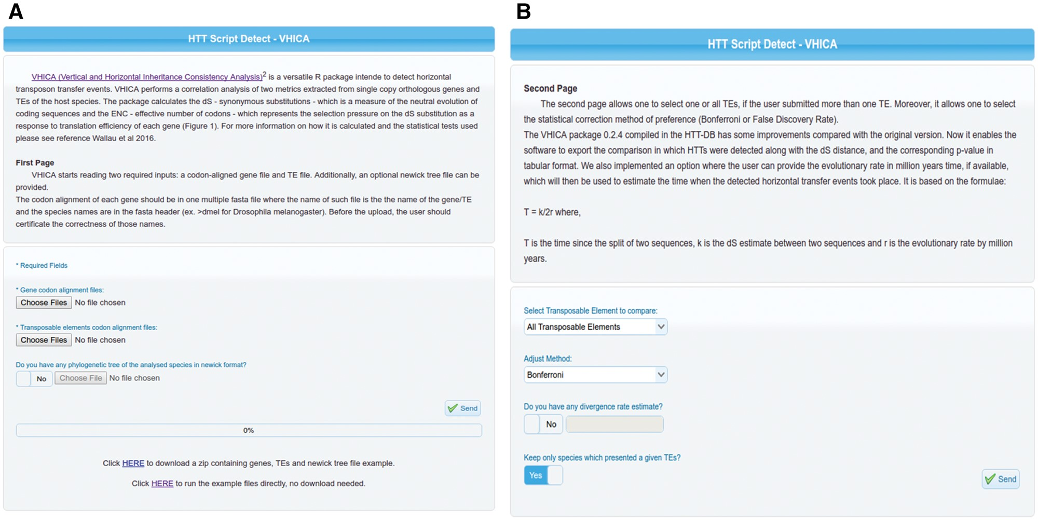
Figure 2. (A) First panel of VHICA interface available for HTT detection through the HTT-DB database. Two optional ...
Notes:
Figure 2. (A) First panel of VHICA interface available for HTT detection through the HTT-DB database. Two optional (Gene Files and TE Files) and one optional box (Phylotree File) for files upload are available as well as an example of all those files used in the original VHICA paper (Wallau et al. 2016). (B) Second panel of VHICA interface. Here, the user can select one, a set of or all TEs for run VHICA. Since VHICA performs multiple comparisons there are two correction methods available for the user choice: Bonferroni and False Discovery Rate. TE divergence rate can be added, and then VHICA will estimate the HT time in Mya. User can also choose if they want to plot the results only for hosts’ species which presented a given TE or maintain all the other species in the plotting step.
Unless provided in the caption above, the following copyright applies to the content of this slide: © The Author(s) 2018. Published by Oxford University Press.This is an Open Access article distributed under the terms of the Creative Commons Attribution License (http://creativecommons.org/licenses/by/4.0/), which permits unrestricted reuse, distribution, and reproduction in any medium, provided the original work is properly cited.

